Slide 1
VLSI Design and Test
A Keynote Talk
Vishwani D. Agrawal
Professor Emeritus
Department of Electrical and Computer Engineering
Auburn University
Auburn, Alabama 36849, USA
June 29, 2018

Slide 2
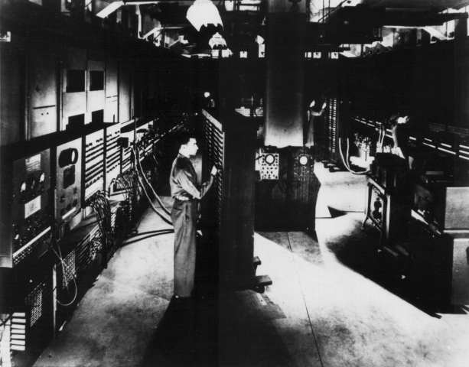
First General-Purpose Computer
Electronic Numerical Integrator and Calculator (ENIAC) built in World War II was the first general purpose computer
Used for computing artillery firing tables
80 feet long, 8.5 feet high and several feet wide
Twenty 10 digit registers, each 2 feet long
Used 18,000 vacuum tubes
5,000 additions/second
Weight: 30 tons
Power consumption: 140kW
© 2004 Morgan Kaufman Publishers

Slide 3
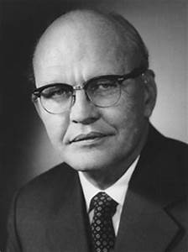
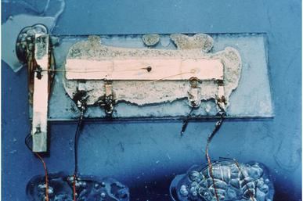
Jack Kilby and His Concept of an IC
1923 – 2005

Slide 4
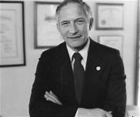
Robert Noyce
1927 – 1990

Slide 5
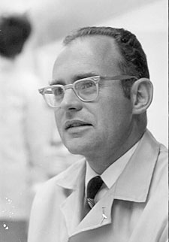
Gordon E. Moore

Slide 6
1965
“Cramming More Components onto Integrated Circuits,” Electronics, vol. 38, no. 8, April 19, 1965.
The complexity for minimum component costs has increased at a rate of roughly a factor of two per year (see graph on next page). Certainly over the short term this rate can be expected to continue, if not to increase. Over the longer term, the rate of increase is a bit more uncertain, although there is no reason to believe it will not remain nearly constant for at least 10 years. That means by 1975, the number of components per integrated circuit for minimum cost will be 65,000.
I believe that such a large circuit can be built on a single wafer.

Slide 7
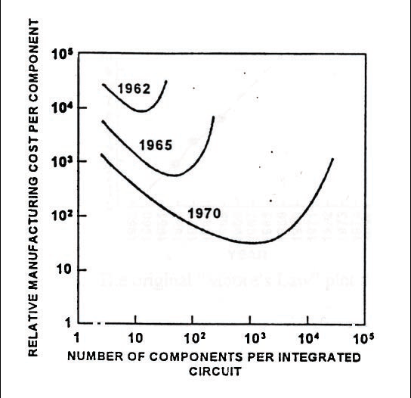
Moore’s 1965 Graph
Shrinking features
Increase defect
density
Components per unit area
Increased by reducing
Feature size
1975
Shrinking feature size →

Slide 8
Economics of VLSI
Assume wafer size and processing cost are fixed.
Increasing chip area will:
Reduce number of chips on a wafer
Reduce chip yield
Increase chip cost
Cost of fabricating and testing a wafer
Chip cost = ⎯⎯⎯⎯⎯⎯⎯⎯⎯⎯⎯⎯⎯⎯⎯⎯⎯⎯⎯
Yield × Number of chip sites on the wafer
Increase functionality also
Cost per function should be minimized.

Slide 9
Increasing Functionality/Area
Increase number of transistors per unit area:
Shrink feature size (λ)
Each generation of VLSI technology reduces λ by a factor 1/√2 = 0.707, doubling number of transistors per unit area
Assume defect density d = k/λ, where k is a constant of proportionality (processing technology parameter)
Area of a component (transistor) is k’λ, where k’ is another constant (design technology parameter)
Chip of area A, number of transistors t = A/(k’λ) or A = tk’λ

Slide 10
Component (Transistor) Cost, Ct
Ct = Chip cost/Number of transistors
(Wafer cost, Wc) k’λ
= ̶ ̶ ̶ ̶ ̶ ̶ ̶ ̶ ̶ ̶ ̶ ̶ ̶ ̶ ̶ ̶ ̶ ̶ ̶ ̶ ̶ ̶ ̶ ̶ ̶ ̶ ̶ ̶ ̶ ̶ ̶ ̶ ̶ ̶ ̶ ̶ ̶ ̶ . ̶ ̶ ̶ ̶ ̶ ̶
Y × (Wafer area, Wa/A) A
Wc k’λ Wc
= ̶ ̶ ̶ ̶ ̶ ̶ ̶ ̶ ̶ ̶ ̶ ̶ ̶ ̶ ̶ ̶ ̶ ̶ ̶ ̶ ̶ ̶ ̶ ̶ ̶ ̶ ̶ ̶ ̶ = ̶ ̶ ̶ ̶ ̶ ̶ k’λ (1 + kk’t / α)^{α}
Wa (1 + Ad/ α) ^{– α} Wa

Slide 11
Component Cost
k’λ
Cost per transistor
(1 + kk’t / α)^{α}
Number of transistors, t →
← λ

Slide 12
Technology Advances
Decreasing k
k’λ
Cost per transistor
(1 + kk’t / α)^{α}
Number of transistors, t →
← λ

Slide 13
1975
“Progress in Digital Integrated Electronics,” IEDM Tech. Digest, 1975, pp. 11-13.
. . . the rate of increase of complexity can be expected to change slope in the next few years as shown in Figure 5. The new slope might approximate a doubling every two years, rather than every year, by the end of the decade.

Slide 14
Figure 5 of Moore’s 1975 Paper
16M
1M
64K
4K
256
16
1
Components per chip
60 65 70 75 80 85
Year

Slide 15
1995
“Lithography and the Future of Moore’s Law,” Proc. SPIE, vol. 2437, May 1995.
By making things smaller, everything gets better simultaneously. There is little need for trade-offs. The speed of our products goes up, the power consumption goes down, system reliability, as we put more of the system on a chip, improves by leaps and bounds, but especially the cost of doing thing electronically drops as a result of the technology.
(SPIE – Society of Photonic Instrumentation Engineers)

Slide 16
Also in the 1995 Paper
. . . I have no idea what will happen beyond 0.18 microns.
In fact, I still have trouble believing we are going to be comfortable at 0.18 microns using conventional optical systems. Beyond this level, I do not see any way that conventional optics carries us any further. Of course, some of us said this about the one micron level. This time, however, I think there are fundamental materials issues that will force a different direction. The people at this conference are going to have to come up with something new to keep us on the long term trend.

Slide 17
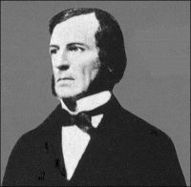
George Boole, 1815 -1864
Born, Lincoln, England
Professor of Math., Queen’s College, Cork, Ireland
Book, The Laws of Thought, 1853
Wife: Mary Everest Boole

Slide 18
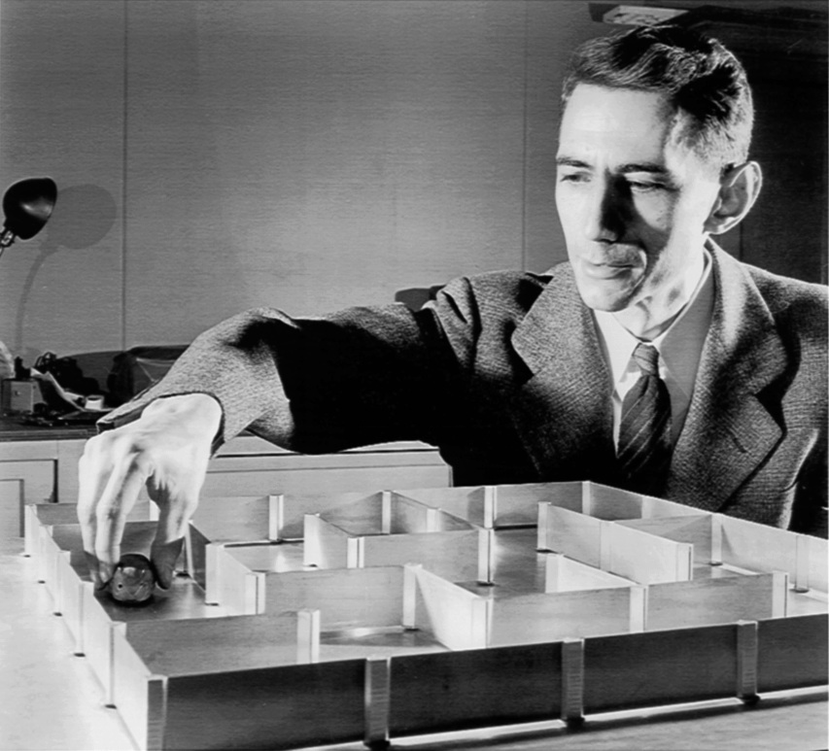
Claude E. Shannon (1916-2001)
http://www.kugelbahn.ch/sesam_e.htm

Slide 19
Shannon’s Legacy
A Symbolic Analysis of Relay and Switching Circuits, Master’s Thesis, MIT, 1940. Perhaps the most influential master’s thesis of the 20th century.
An Algebra for Theoretical Genetics, PhD Thesis, MIT, 1940.
Founded the field of Information Theory.
C. E. Shannon and W. Weaver, The Mathematical Theory of Communication, University of Illinois Press, 1949. A “must read.”

Slide 20
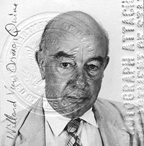
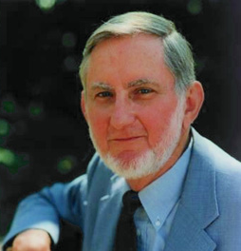
Quine-McCluskey
Willard V. O. Quine
1908 – 2000
Edward J. McCluskey
1929 – 2016

Slide 21
Quine-McCluskey Tabular Minimization Method
W. V. Quine, “The Problem of Simplifying Truth Functions,” American Mathematical Monthly, vol. 59, no. 10, pp. 521-531, October 1952.
E. J. McCluskey, “Minimization of Boolean Functions,” Bell System Technical Journal, vol. 35, no. 11, pp. 1417-1444, November 1956.

Slide 22
2018
Problems arising with technology advances:
High power consumption
Power density
Leakage
Process variation – larger as a fraction of feature size
Increased noise sensitivity
Problems with design:
Verification of correctness – logic and timing
Ensuring reliable operation
Testing complexity – time, power and cost
Security

Slide 23
Energy per Operation (EPO)
1.0
0.5
0.0
EPO
Power
TPO
1 2 3 4 5
V_{DD} / V_{th}

Slide 24
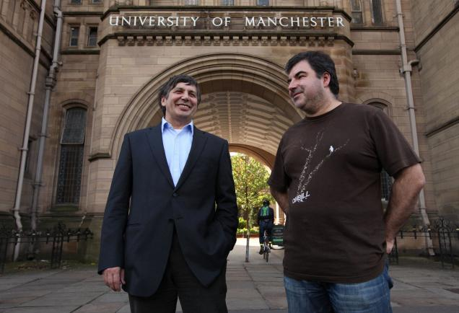
Andre Geim and Konstantin Novoselov
Nobel Prize in Physics, 2010

Slide 25
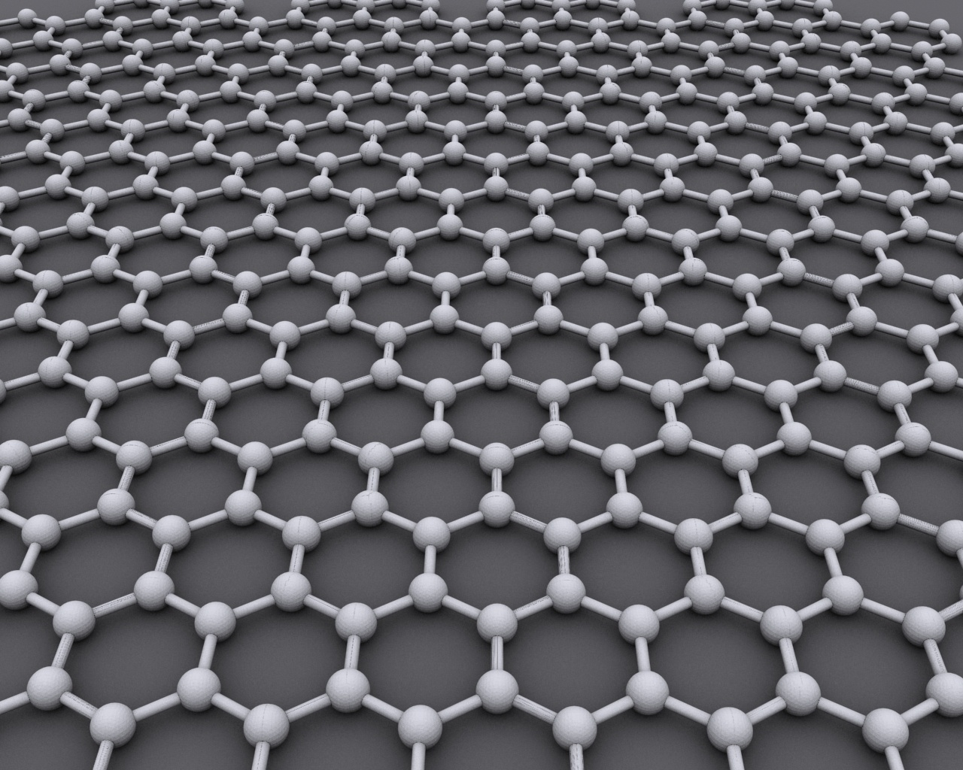
Graphene
Graphene
0.14nm

Slide 26
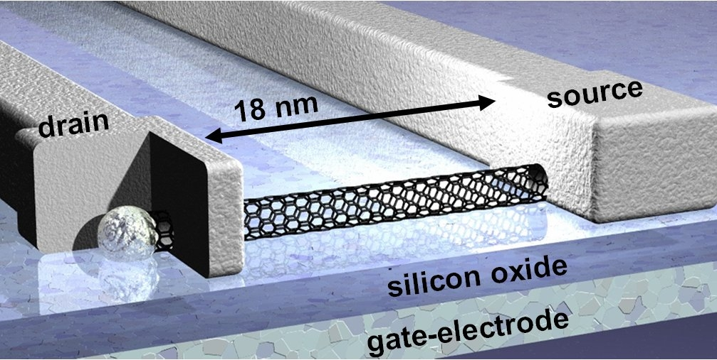
Carbon Nanotube Transistor
Infineon, Munich, Germany – November 22, 2004
graphene tube

Slide 27
CNT Implementations
1,000X Energy efficiency over MOSFET memories.
M. M. S. Aly, et al., “Energy Efficient Abundant-Data Computing: The N3XT 1,000x,” Computer (IEEE Computer Society), Dec 2015, pp. 24 – 33.
M. M. Shulaker, et al., “Three-dimensional Integration of Nanotechnologies for Computing and Data Storage on a Single Chip,” Nature, Vol. 547, 6 July 2017, pp. 74 – 78.

Slide 28
Beyond von Neumann
The Computer and the Brain, J. von Neumann, New Haven: Yale University Press, 1958 (or later editions).
Is parallel computing the answer?
Or,

Slide 29
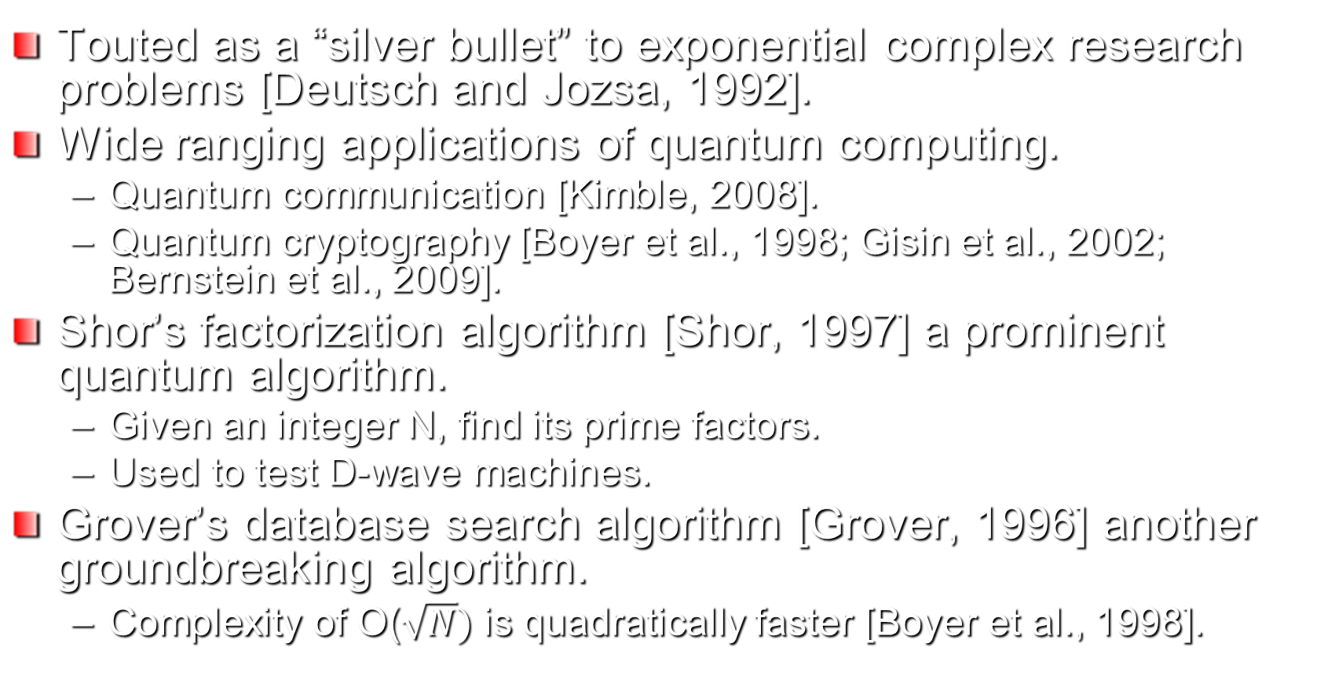
Quantum Computing
Touted as a “silver bullet” to exponential complex research problems [Deutsch and Jozsa, 1992].
Wide ranging applications of quantum computing.
Quantum communication [Kimble, 2008].
Quantum cryptography [Boyer et al., 1998; Gisin et al., 2002; Bernstein et al., 2009].
Shor’s factorization algorithm [Shor, 1997] a prominent quantum algorithm.
Given an integer N, find its prime factors.
Used to test D-wave machines.
Grover’s database search algorithm [Grover, 1996] another groundbreaking algorithm.
Complexity of O($\sqrt{N})$ is quadratically faster [Boyer et al., 1998].

Slide 30

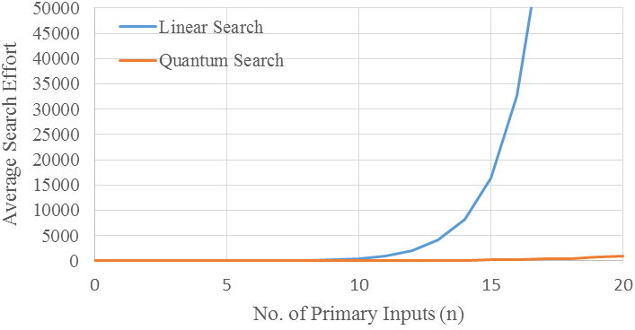

Grover’s Algorithm (contd..)
Average Search Effort ($\sqrt{N})$
0
32
1024
32768
1048576
Database size (N)
Average search effort vs. Database size comparison of Grover’s Search and Linear Search.

Slide 31
Final Thoughts

Slide 32
This is the 22nd symposium. Most of you are aware of another conference, the 32nd International Conference on VLSI Design that will be held in the Delhi/NCR area in January 2019. That conference started in 1985 in Chennai. Although VLSI technology was there in 1985, many things were yet to come. Email and mobile phone were yet to come. TV had no flat panel. Cameras still needed film. All those have changed but could we have predicted? You can trace the presence of VLSI as the backbone of these changes.
Today, we have things that were quite unthinkable 30 years ago, such as, the internet of things (IoT), cloud computing, drones and robots, autonomous cars. There will also be things that we cannot imagine now. Whether MOSFETs are replaced by CNFETs or by some other devices, or whether quantum computers replace digital computers, I am sure VLSI will continue to revolutionize our life in an unpredictable way, I hope for the better.

