Slide 1
Project Title
Team Members Names

Slide 2
Overview
Project Description

Slide 3
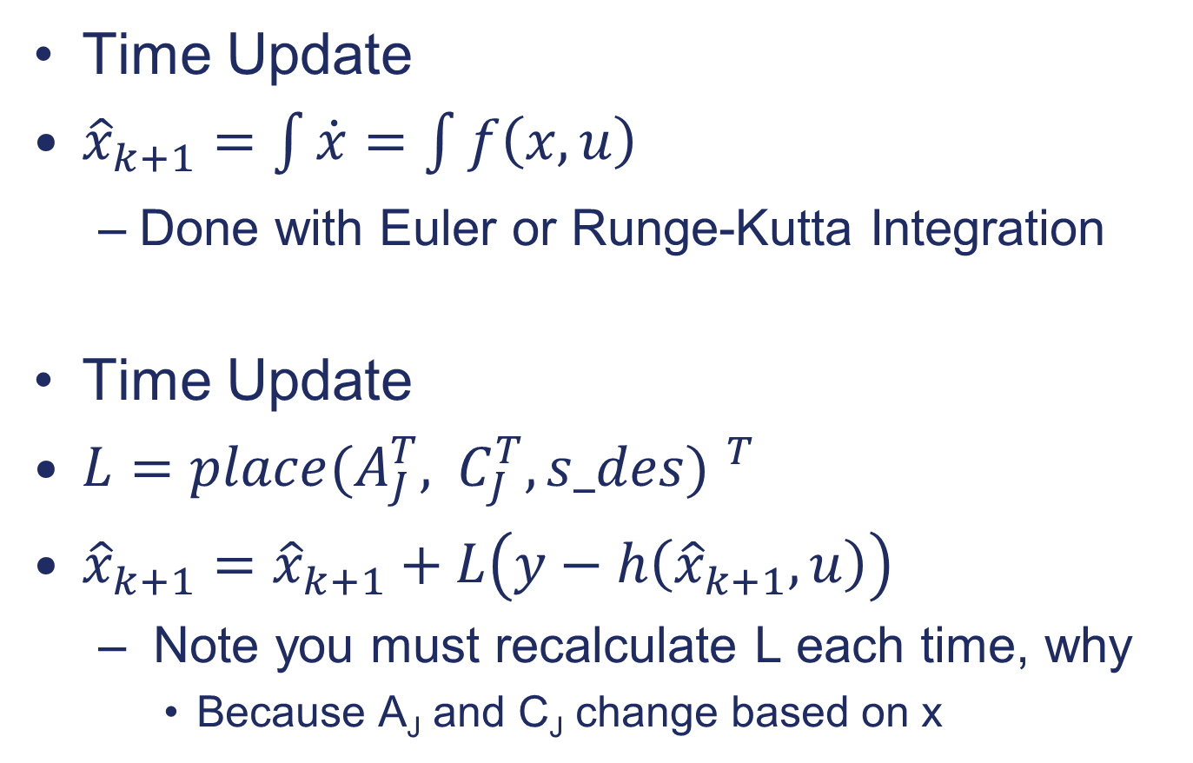
Methodology
Time Update
${\hat{x}}_{k+1}=\int{\dot{x}}=\int{f\left(x,u\right)}$
Done with Euler or Runge-Kutta Integration
Time Update
$L={place(A_{J}^{T}, C_{J}^{T},s_des) }^{T}$
${\hat{x}}_{k+1}={\hat{x}}_{k+1}+L\left(y−h\left({\hat{x}}_{k+1},u\right)\right)$
Note you must recalculate L each time, why
Because A_{J} and C_{J} change based on x

Slide 4
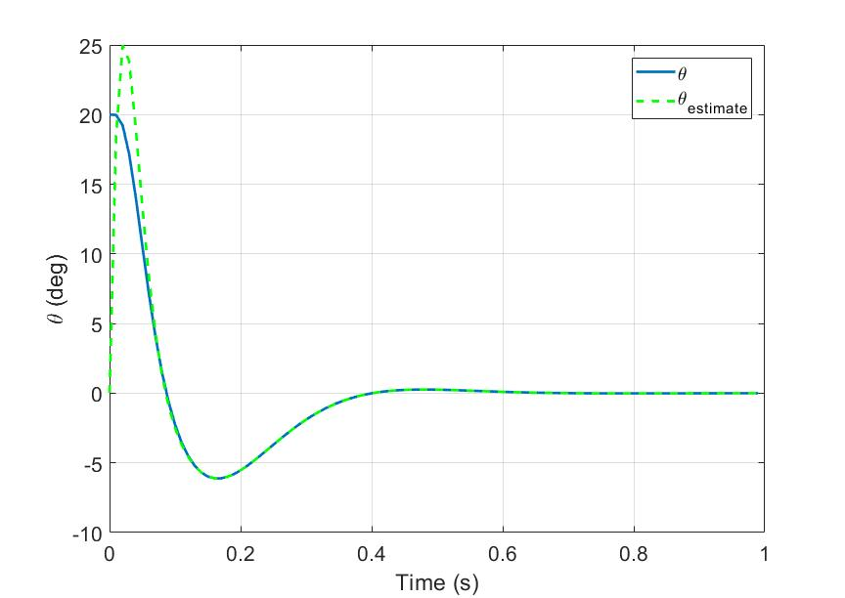
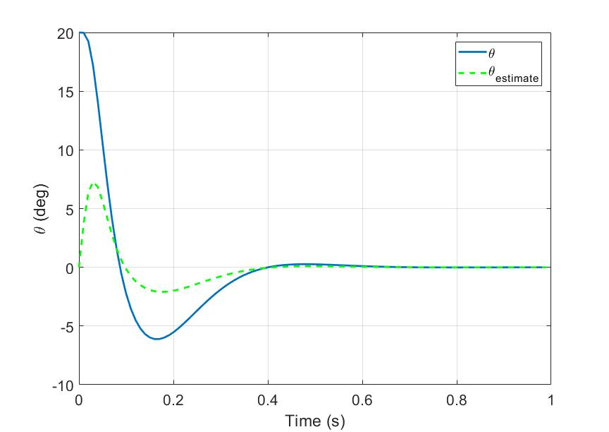

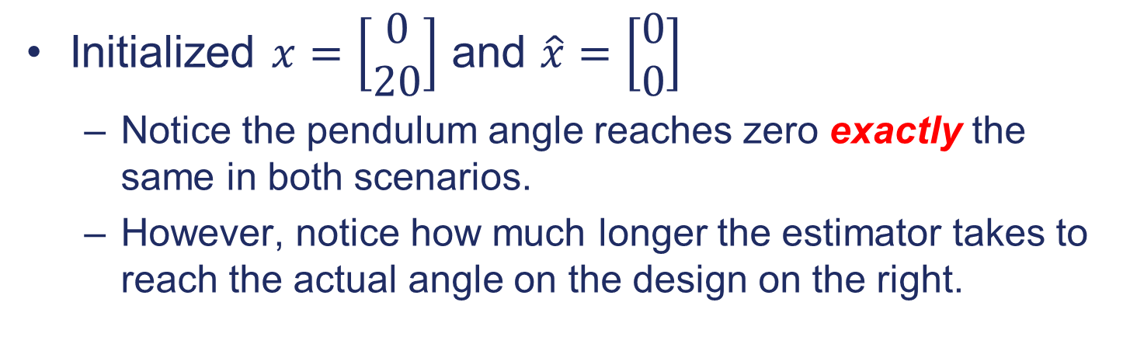



Results
Initialized $x=\left[\begin{matrix}0 \\ 20\end{matrix}\right]$ and $\hat{x}=\left[\begin{matrix}0 \\ 0\end{matrix}\right]$
Notice the pendulum angle reaches zero exactly the same in both scenarios.
However, notice how much longer the estimator takes to reach the actual angle on the design on the right.
$$K=\left[\begin{matrix}99 & 4975\end{matrix}\right]$$
$$K=\left[\begin{matrix}19 & 175\end{matrix}\right]$$
$$L={\left[\begin{matrix}156 & 19\end{matrix}\right]}^{T}$$
$$L={\left[\begin{matrix}4876 & 99\end{matrix}\right]}^{T}$$

