Slide 1
Data Center Specific Thermal and Energy Saving Techniques
Tausif Muzaffar and Xiao Qin
Department of Computer Science and
Software Engineering
Auburn University

Slide 2
Big Data

Slide 3
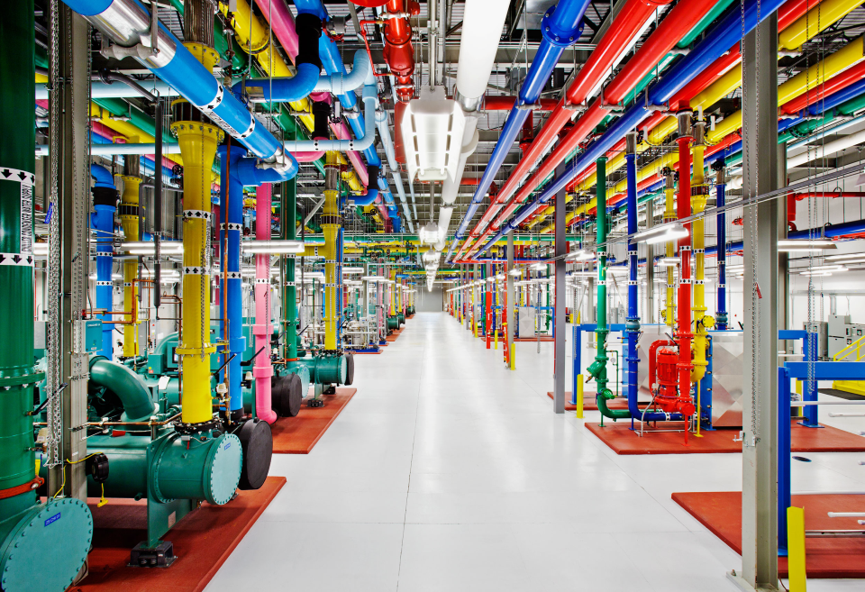
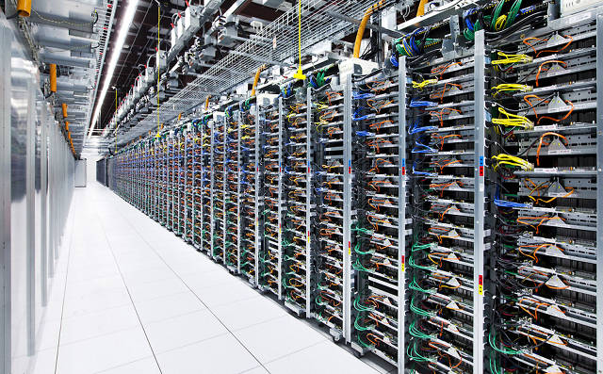
Data Centers
In 2013, there are over 700 million square feet of data centers in united states
Data centers account for 1.2% of all data power consumed in United States

Slide 4
Thermal Model
Part 1

Slide 5
Data Center Power Usage

Slide 6
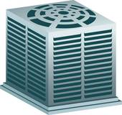
Thermal Recirculation
Server i+1
$$Outlet Tempterature$$
$$Intial Tempterature$$
Server i
$$Inlet Tempterature$$
$$Supplied Tempterature$$
Server i-1
Workload
CRAC

Slide 7
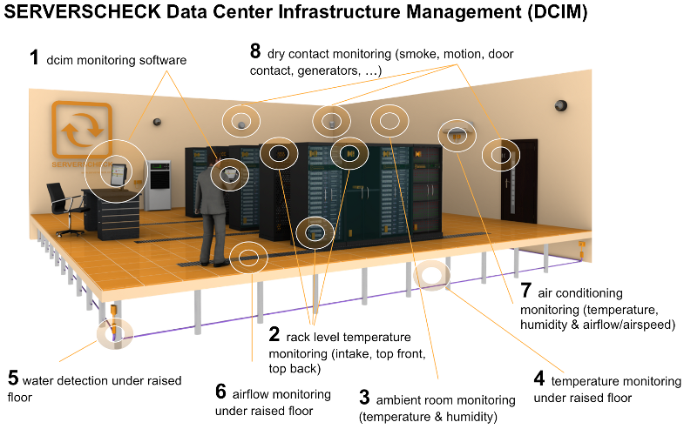
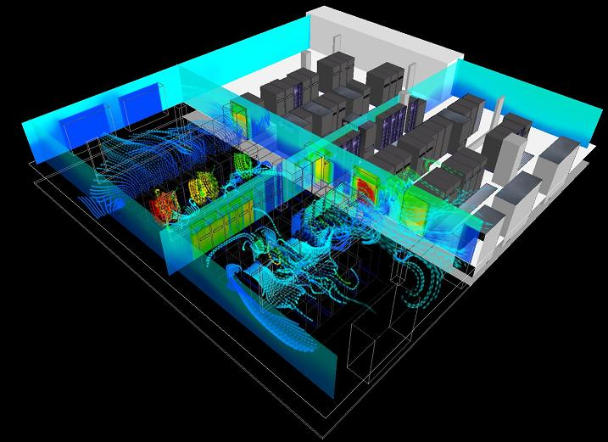
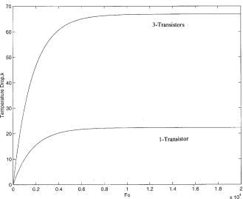
Thermal Recirculation Management
Sensor Monitoring
Thermal Simulations
Thermal Model

Slide 8
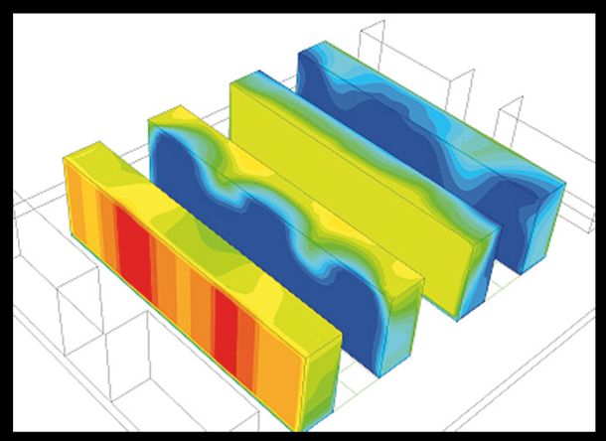
Prior Thermal Models
Some are based on power rather than workload
Ignore I/O heavy applications
Requires some sensor support
Not easily ported to different platforms

Slide 9
Research Goal
iTad: making a simple and practical way to estimate the temperature of a data node based on
CPU Utilization
I/O Utilization
Average Conditions of a Data Center
Notes:
iTad – I/O Thermal Aware Data-Center
Our goal was to make a simple and practical way to estimate the temperature of a data node based on
CPU Utilization
I/O Utilization
Average Conditions of Data Center
Our model is based on theory of heat transfer and our experiments are based on actual implementation rather than simulation

Slide 10
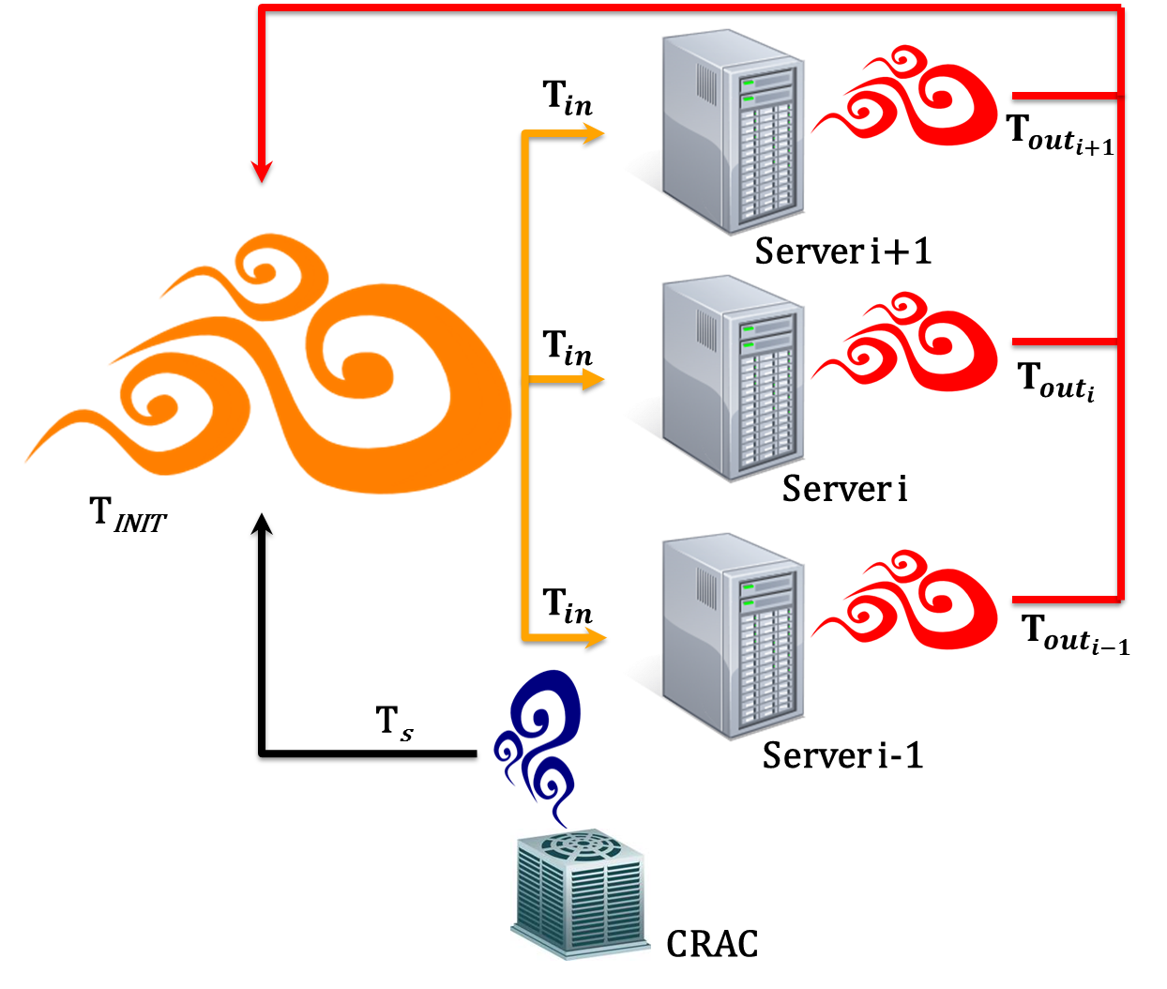
Typical Recirculation Models
The initial temperature of the room will circulate
The servers will run and heat its output air at different rates
The supply air from the AC unit will try to negate the extra heat from the servers

Slide 11
Our Focus
To focus on each server separately and find the outlet temperature
To estimate inlet temperature based on that outlet temperature
Server Model
Inlet
Inlet Model
Outlet
T_{INIT}
Server i
Notes:
Instead of modeling the entire data center as a whole we focus on each server separately and find the outlet temperature

Slide 12
Server Model
Three factors affect the output temperature of a single node
Inlet Temperature
CPU Workload
I/O Workload
T_{out}
Server i
T_{INIT}
CPU Workload
I/O Workload

Slide 13
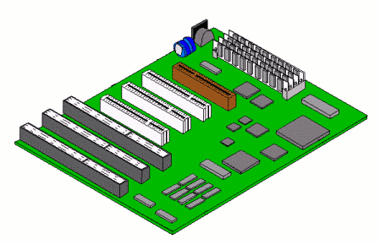
Server Model Diagram
Convective Heat Transfer
T_{INIT}
T_{out}
Radiant Heat Transfer
Server i
Workload

Slide 14
Equation Notation

Slide 15
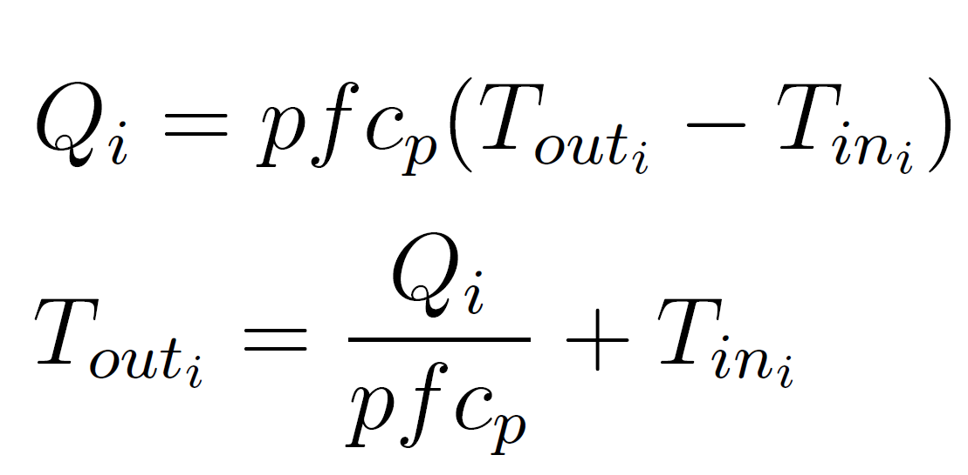
Server Model Equations
(1) Convective Heat Transfer of Server
(2) Radiant Heat Transfer of Server
(3) Change in temperature
Notes:
Hr: heat transfer coefficient
A: surface area

Slide 16
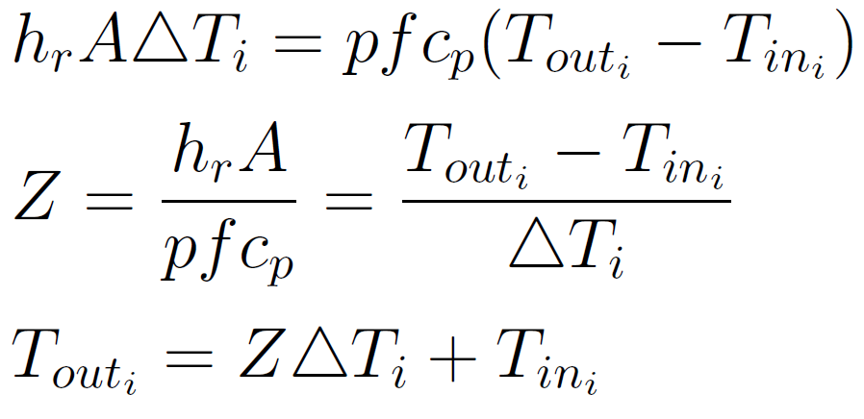
Server Model Equations
(4) Set Radiant and Convection equal to each other and solve for Tout

Slide 17
Workload Model
To assess how the CPU and I/O effect workload
CPU
Workload
CPU
Components
I/O
Workload
I/O
Components
Notes:
We also developed a workload model that will assess how the CPU and I/O effect work load

Slide 18
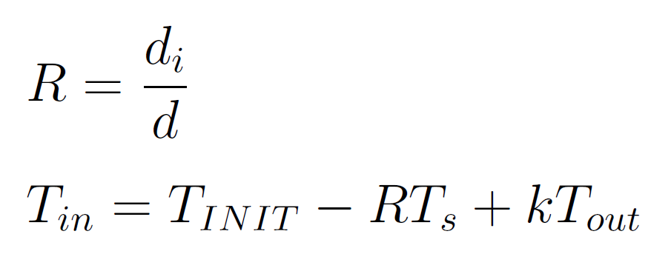
Inlet Model
After the first run we need to update the inlet temperature to do that we developed this model
T_{s}
T_{INIT}
T_{in}
T_{out}
Notes:
di is hight
Floor: di=0
Top: di=d

Slide 19
Determining Parameters
To implement this model we need to get the following constants
Maximum I/O and CPU can affect the outlet temperature
Z which is a collection of constants

Slide 20
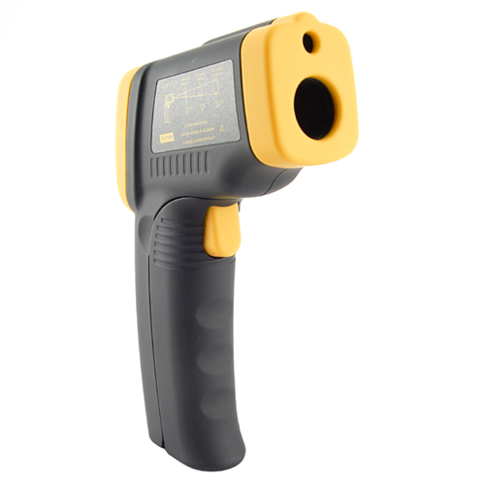
Gathering Values
We thermometers to gather inlet and outlet temperatures
We used infrared thermometers to get the surface temperature

Slide 21
Test Machines

Slide 22
Data Capture
We gathered surface temperature and stored the values like so
29.9
29.9
28.2
CPU: 100%
I/O: 0-8%
Avg: 35.2
CPU: 0-10%
I/O: 100%
Avg: 34.6
30.6
30.6
32.6
30.6
33.1
32.9
33
32.3
33.2
32
33.2
CPU: 0-5%
I/O: 0-5%
Avg: 33.7
29.9
29.7
32.1
32
31.4
32.6
33.6
30.1
30.1
32.5
31.8
37.1
35.1
37.2
34.1
32
31
34.5
29.8
29.9
30.3
34.2
34.9
34.2
33.4
27.9
26.9
30.4
24.3
29.9
45.2
25.5
40.2
44.4
40.4
59.6
49.7
39.4
36.9
40.2
46.4
39.4
39.4
46.7
36.7
43.2
36.1
47.3
57.8
35.1
38
37
37.3
33.8
34.7
30.1
30.1
30.1
30
31.6
29.2
29.4
29.2
30.9
30.1
31.2
30.5
30,2
29.8
30.2
30.5
29.4
30.1
33
35
31.9
29.2
29.8
30.2
29.8
29.7
30.4
29.9
31
29.9
31.2
30.1
29.8
29.9
29.7
29.8
29.9
31.4
30.1

Slide 23
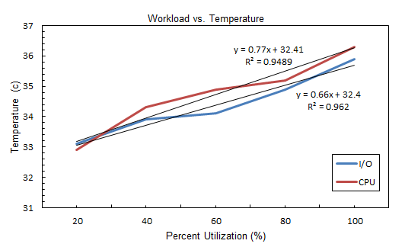
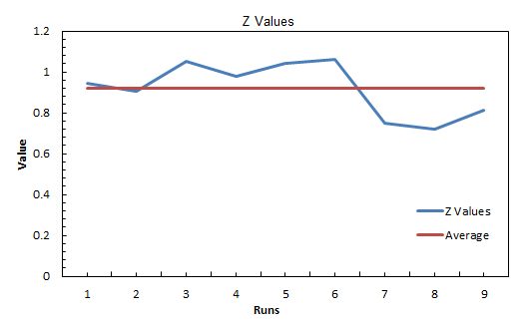
Determining Constants
We observed the rate in changed with CPU and I/O
We used the values to calculate Z

Slide 24
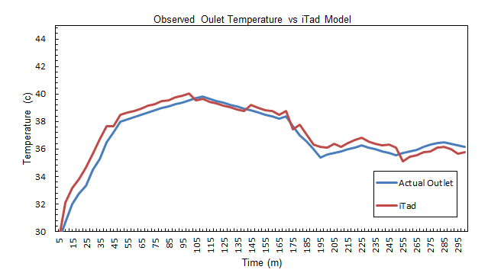
Verification
After getting the constants we ran a live test where we had a computer run tasks and we measured actual outlet temperatures vs. model outlet temperature

Slide 25
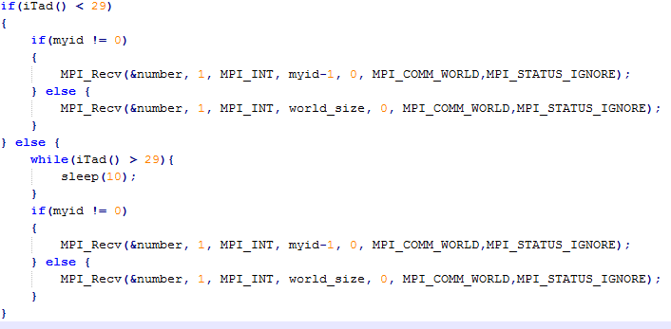
Implementations
MPI using iTad to decisions

Slide 26
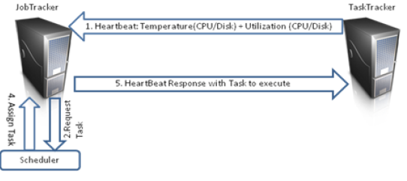
Implementations
We added iTad to Hadoop Heartbeat
iTad

Slide 27
Future Work
Extend the recirculation factor
Determine different components surface radiation
Increasing # Disks to See Effect

Slide 28
Hadoop Disk Energy Efficiency
Part 2

Slide 29
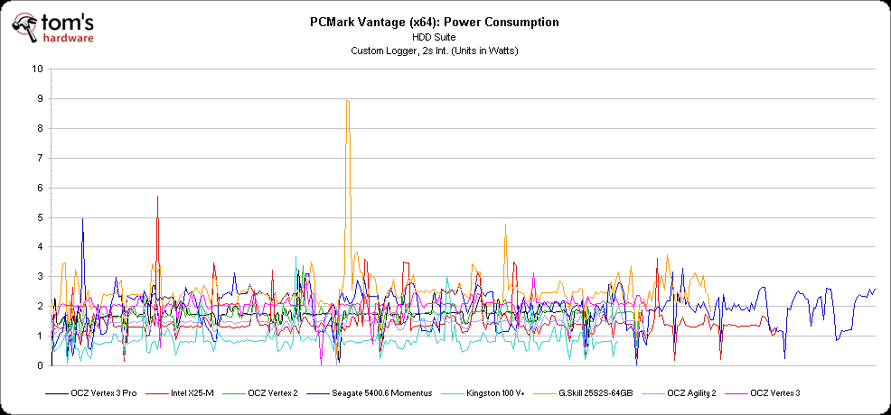
Disk Energy
Disk drives varies in energy
Disks can be a significant part of a server

Slide 30
Single-Disk Server Power Usage

Slide 31
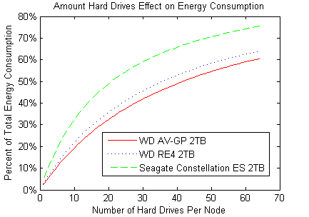
Scaling Server Disk #
With every added disk, hard drive energy plays a bigger role

Slide 32
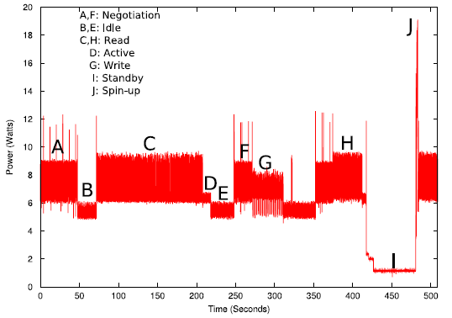
Disk Dynamic Power
Disks tend to have different consumption modes
Active
Idle
Standby

Slide 33
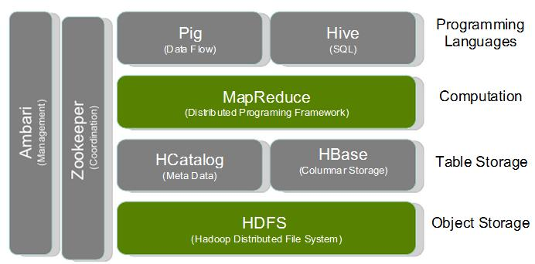
Hadoop Overview
Parallel Processing
Map Reduce
Distributed Data

Slide 34
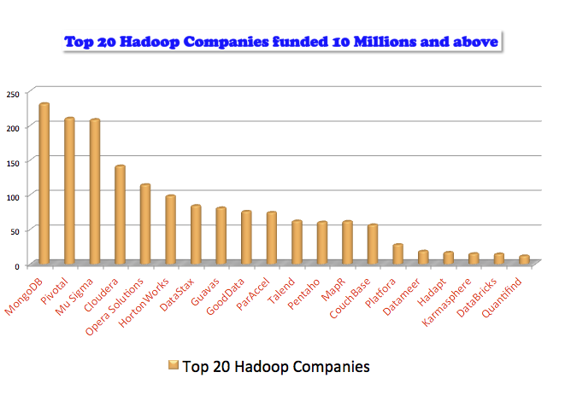
Hadoop Benefits
Industry Standard
Large Research Community
I/O Heavy

Slide 35
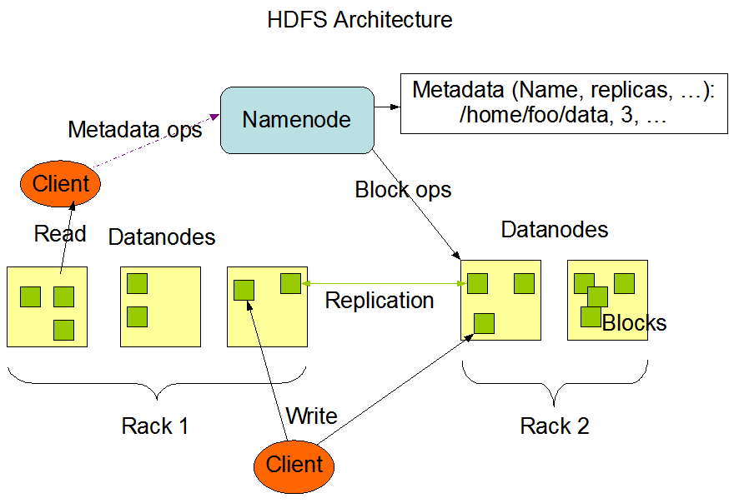
Hadoop Architecture
Hadoop creates multiple replicas
Metadata is managed on name node
Nodes can have multiple disks

Slide 36
Research Goal
NAP – E(N)ergy (A)ware Disks for Hadoo(P)
Built for high energy efficiency
Designed for Hadoop clusters

Slide 37
Setup
3-node cluster
Each node identical
4 disks
4gb RAM
Cloudera Hadoop
Power meter

Slide 38
Optimizations
We group disks together
I/O Limits
More time for disks to sleep

Slide 39
Naïve (Reactive) Algorithm
Simply turn off all drive until needed

Slide 40
Proactive Algorithm
Turn on next drive before its needed
Threshold

Slide 41
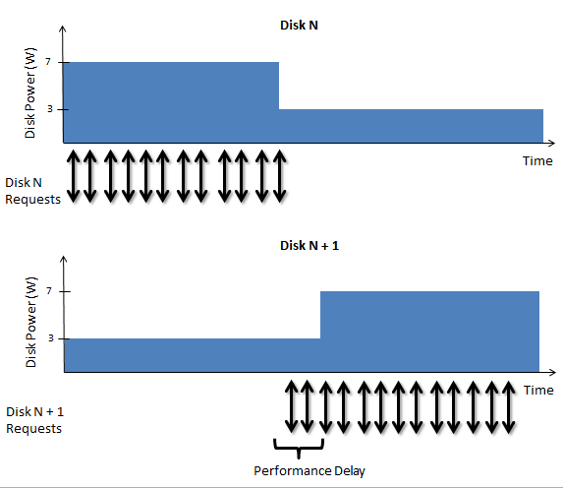
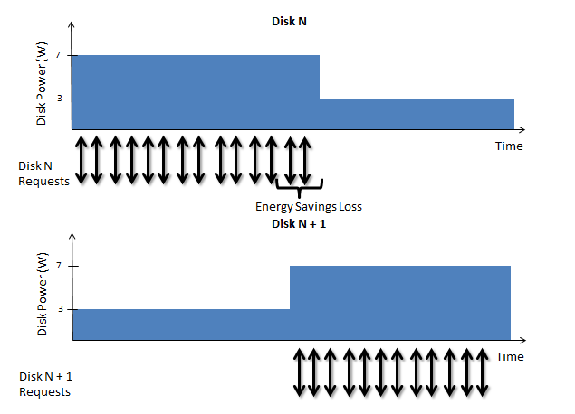
Comparing the Algorithms
Reactive
Predictive

Slide 42
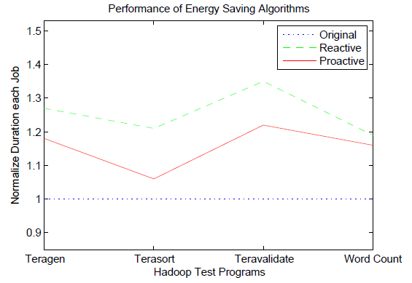
Speed
Reactive does worse than proactive
Time increase low

Slide 43
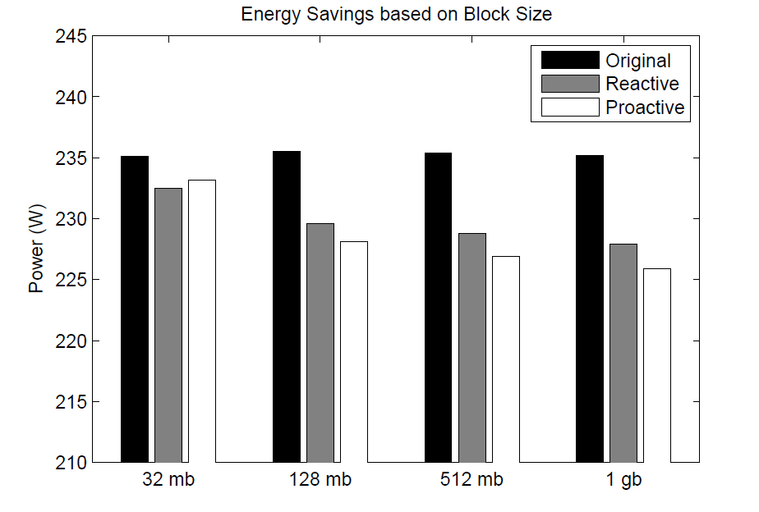
Block Size
Effects how HDFS stores files
Effects how fast it processes

Slide 44
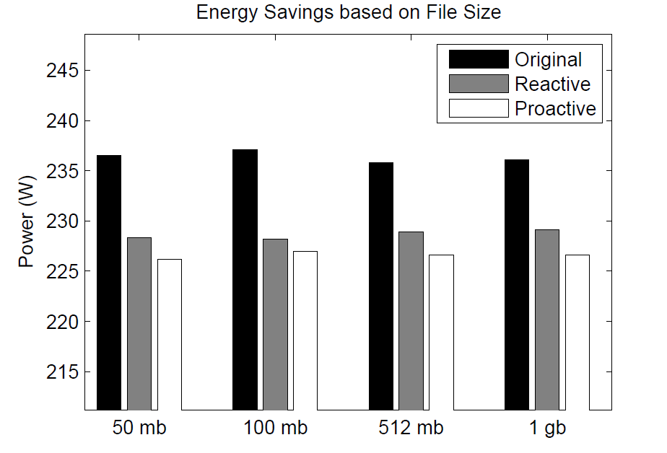
File Size
Effects how blocks are made
Effect data locality

Slide 45
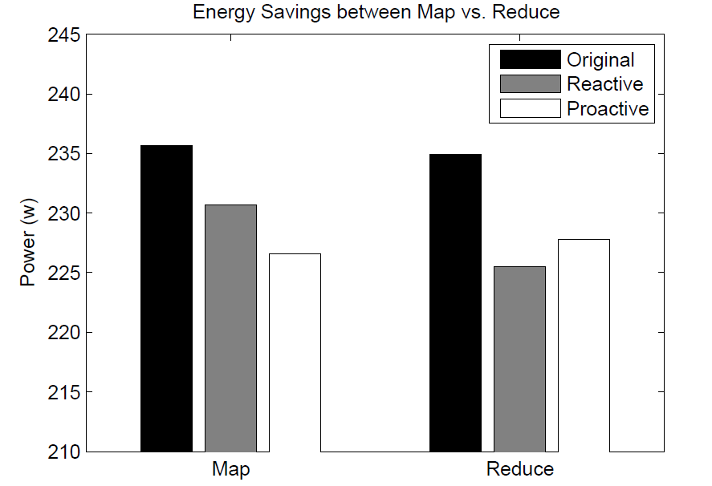
Map vs. Reduce
Map is more I/O intensive usually
Reduce was usually shorter

Slide 46
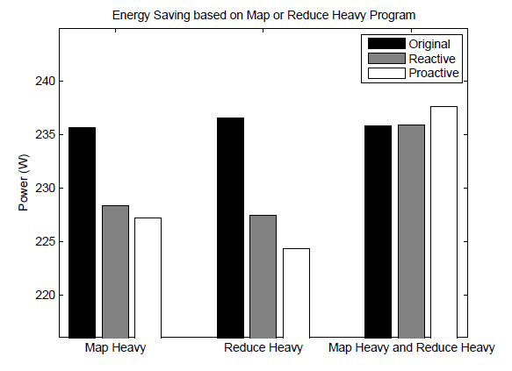
Map Heavy vs. Reduce Heavy
Map Heavy is more I/O intensive
Map and Reduce Heavy gets no gain

Slide 47
PRE-BUD Model
Prefetching Energy-Efficient Parallel I/O Systems with buffer Disk

Slide 48
NAP Energy Model
Find added energy by disks
Group can either be standby or active
Read and writes assumed same

Slide 49
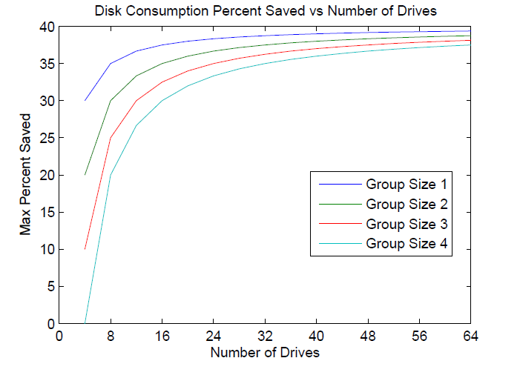
Energy Saving Simulation
Notes:
Group size 1: 1 active disk at a time
Group size 4: 4 active disks at a time

Slide 50
Summary
iTad: a simple and practical way to estimate the temperature of a data node
NAP: an energy-saving technique for disks in Hadoop clusters
Notes:
iTad – I/O Thermal Aware Data-Center
Our goal was to make a simple and practical way to estimate the temperature of a data node based on
CPU Utilization
I/O Utilization
Average Conditions of Data Center
Our model is based on theory of heat transfer and our experiments are based on actual implementation rather than simulation

Slide 51
Questions

