Slide 1
Reliability Analysis of An Energy-Aware RAID System
Shu Yin
Xiao Qin
Auburn University

Slide 2
Presentation Outline
Motivation;
    Related Work;
    MREED Model;
    Experimental Result;
    Conclusion/Future Work.

Slide 3
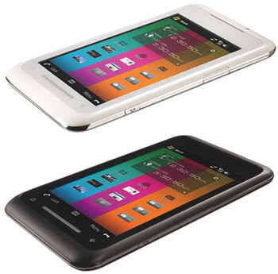
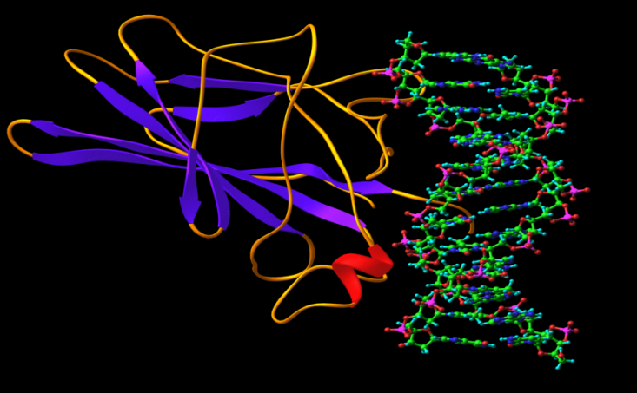
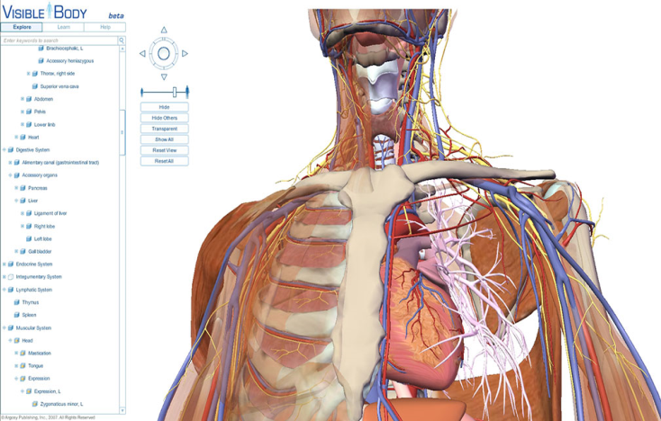
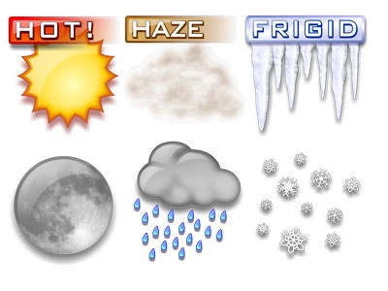
Motivation
Mobile Multimedia
Bio- Informatics
3D Graphic
Weather Forecast
  Data-Intensive Applications

Slide 4



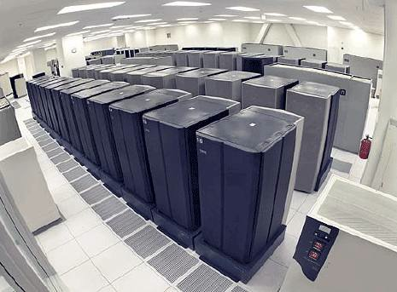
Cluster in Data Center
  Cluster System

Slide 5
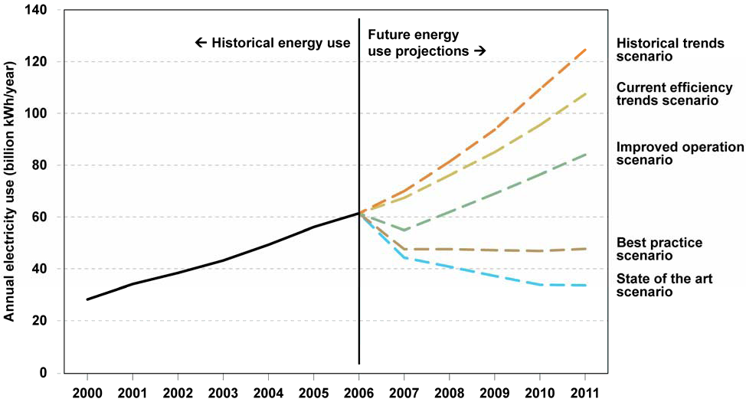
Problem: Energy Dissipation
EPA Report to Congress on Server and Data Center Energy Efficiency, 2007

Slide 6
Problem: Energy Dissipation (cont.)
Using 2010 Historical Trends Scenario
  Server and Data Centers Consume 120 Billion kWh per year;
  Assume average commercial end user is charged 9.46 kWh;
  Disk systems can account for 27% of the computing energy cost of data centers.
Server and data centers may have an electrical cost of
10.4 Billion Dollars!!!

Slide 7

Existing Energy Conservation Techniques
Software- directed Power Management
Dynamic Power Management
Redundancy Technique
Multi- speed Setting
How Reliable Are They ?

Slide 8

Contradictory of Energy Efficiency and Reliability
Energy Efficiency
Reliability
Example: Disk spin up and down

Slide 9
MREED Model
  R= R_{BaseValue}^{[1]}*τ+α*R(f)^{[2]}
Baseline Failure Rate Derived from Disk Utilization
Temperature Factor
R(f)=1.51e⁻⁶f² – 1.09e⁻⁵f + 1.39e⁻²
Coefficient to R_{BaseValue}, α=1 in our research
[1] E. Pinheiro, W.-D. Weber, and L.A. Barroso. Failure trends in a large disk drive population. Proc. USENIX Conf. File and Storage Tech., February2007.
[2] IDEMA Standards. Speciﬁcation of hard disk drive reliability.

Slide 10
MREED Model
(Temperature Factor τ^{[3]})
Temperature (˚C) | Acceleration Factor | De-rating Factor | Adjusted MTBF
25 | 1.000 | 1.00 | 232.140
26 | 1.0507 | 0.95 | 220.553
30 | 1.2763 | 0.78 | 181.069
34 | 1.5425 | 0.65 | 150.891
38 | 1.8552 | 0.54 | 125.356
42 | 2.2208 | 0.45 | 104.463
46 | 2.6465 | 0.38 | 8.123
[3] G. Cole, “Estimating Drive Reliability in Desktop Computers and Consumer Electronics Systems”
Seagate Personal Storage Group, 2000

Slide 11
MREED Model
(MATHEMATICAL RELIABILITY MODELS FOR ENERGY-EFFICIENT RAID SYSTEMS)

Slide 12
MREED Model
(MATHEMATICAL RELIABILITY MODELS FOR ENERGY-EFFICIENT RAID SYSTEMS)
Access Pattern
Temperature
Energy-Conservation RAID Technique
Frequency
Weibull Distribution
Analysis
Annual Failure Rate
System Level Reliability
System Reliability

Slide 13
Weibull Analysis
A Leading Method for Fitting Life Date
Advantages:
  Accurate
  Small Samples
  Widely Used

Slide 14
MREED Model
(Energy Conservation Techniques- PARAID)
Soft
state
RAID
Gears
Power-Aware RAID (PARAID)^{[4]} System Structure
[4] Charles Weddle, Mathew Oldhan, Jin Qian, An-I Andy Wang. PARAID- A Gear-Shifting Power-Aware RAID.
USENIX FAST 2007.

Slide 15
Model Validation
Techniques
  Run the Systems for A Couple of Decades
  The Event Validity Validation Techniques^{[5]}
[5] R.G. Sargent, “Verification and Validation of Simulation Models”, in Proceedings of the 37th conference on Winter Simulation, ser. WSC’05 Winter Simulation Conference, 2005.

Slide 16
Model Validation
Challenges
  Unable to Monitor PARAID Running for Years
  Sample Size is Small from A Validation Perspective (e.g. 100 Disks for Five Years)

Slide 17
Model Validation
(DiskSim^{[6]} Simulation)
Input Trace
(File Level)
File to Block Mapper
Simulate File
(Block Access)
DiskSim
(Block Level)
File to Block Level Converter Outline
[6] S.W.S John, S. Bucy, Jiri Schindler and G.R. Ganger, “The DiskSim Simulation Environment Version 4.0 Reference Manual”, 2008

Slide 18
Model Validation
(DiskSim Simulation)
Driver 0
Bus 0
CTLR 0
CTLR 1
CTLR 2
CTLR 3
CTLR 4
BUS 0
BUS 1
BUS 2
BUS 3
BUS 4
Driver 0
Driver 1
Driver 2
Driver 3
Driver 4
Diagram of the Storage System Corresponding to the DiskSim RAID-0

Slide 19
Model Validation
(Result)
Utilization Comparison Between MREED and DiskSim Simulator

Slide 20
Model Validation
(Result)
Gear Shifting Comparison Between MREED and DiskSim Simulator

Slide 21
Reliability Evaluation
(Experimental Setup)
Disk Type | Seagate ST3146855FC
Capacity | 146 GB
Cache Size | Sata 16MB
Buffer to Host Transfer Rate | 4Gb/s (Max)
Total Number of Disks | 5
File Size | 100 MB
Number of Files | 1000
Synthetic Trace | Poisson Distribution
Time Period | 24 Hours
Interval Time (Time Phase) | 1 Hour
Power On Hour Per Year | 8760 Hours

Slide 22
Reliability Evaluation
(Disk Utilization Comparison)
Disks Utilization Comparison Between PARAID-0 and RAID-0 at A Low Access Rate
(20 Times Per Hour)

Slide 23
Reliability Evaluation
(Disk Utilization Comparison)
Disks Utilization Comparison Between PARAID-0 and RAID-0 at A High Access Rate
(80 Times Per Hour)

Slide 24
Reliability Evaluation
(AFR Comparison)
AFR Comparison Between PARAID-0 and RAID-0 at A Low Access Rate
(20 Times Per Hour)

Slide 25
Reliability Evaluation
(AFR Comparison)
AFR
AFR Comparison Between PARAID-0 and RAID-0 at A High Access Rate
(80 Per Hour)

Slide 26
Future Work
Extend the MREED Model Power-Aware RAID-5;
  Data Stripping
Investigate Trade-off Between Reliability & Energy-Efficiency ;
Evaluate and Compare an array of energy-saving techniques with respect to specific application domains;

Slide 27
Conclusion
A Reliability Model (MREED) for Power-Ware RAID;
Weibull Distribution Analysis to MREED;
Validation of MREED;
Impacts of the Gear-shifting on Reliability of PARAID.

Slide 28
Thanks

Slide 29
Questions
?

