Slide 1

Distributed Learning for Multi-Channel Selection in Wireless Network Monitoring
— Yuan Xue, Pan Zhou, Tao Jiang, Shiwen Mao and Xiaolei Huang

Slide 2
Outline
Background & Goal
Problem Formulation
Algorithms
Experiment
Conclusion

Slide 3
Background
In wireless monitoring, channel selection, i.e., how to choose channels with best (or worst) qualities timely and accurately can be tricky
With the channel information initially unknown, adaptive channel allocation methods are needed
While dedicated devices such as sniffers are implemented, coordination between multiple devices is an essential problem
Applications in resource allocation, mission-critical scenarios, disaster recovery and military tasks

Slide 4
Goal
Optimal channel selection
  With channel activities initially unknown, collecting channel information gradually during a sequential learning process
  Make best decision within limited time budget
Coordination between devices
  For passive devices, they can communicate without inferences to make best choice
  For active devices, interferences are taken into consideration

Slide 5
Problem Formulation
We need an adaptive learning method for channel selection
To achieve a trade-off between time/resource budget and accuracy, we formulate this problem as a novel branch of the classic multi-armed bandit (MAB) problem, namely exploration bandit problem
For multiple monitoring devices, we convert the original problem into a distributed exploration bandit problem

Slide 6
Multi-armed Bandit (MAB) Problem
MAB is an online learning problem for decision making
It is a classic example of tradeoff between exploration and exploitation, which aims to achieve the maximum cumulative sum of rewards in the learning process
For channel selection in wireless monitoring, sniffers also need to make decisions of choosing best channel through the learning process, thus MAB algorithms work

Slide 7
Exploration Bandit Problem
A new branch of MAB
In the fixed budget setting , players should seek for a single best arm or a best subset of arms within a fixed time budget
Exploration bandit methods have more accurate results in the channel selection of wireless monitoring because they can spend more time on ‘bad’ channels

Slide 8
Distributed Exploration Bandit
An challenging problem under distributed environment, which remains unsolved
In fixed budget setting, different players make their own decisions independently in a limited time
For multiple players (sniffers in our case), how to avoid interferences and achieve higher reward in the meantime is the main problem

Slide 9
Collision！
Active Sniffers
without Communications

Slide 10
Algorithms
Single sniffer channel selection algorithm
  Sequential Multiple Elimination (SME) algorithm separates the time budget into several rounds, and keeps eliminating unwanted channels while it learns the channel information
  SME allows sniffers to reduce the number of samples constantly during the process of channel monitoring, and guarantees each channel has been sampled enough times before been dropped

Slide 11
Single Sniffer Channel Selection

Slide 12
Algorithms
Multiple sniffers without communication
  Different sniffer will access to different channel at the same time, and they will go through all channels in a round-robin fashion
  Efficiency is quite low, and might need a central controller

Slide 13
Multiple Sniffers
without Communications

Slide 14
Multiple Sniffers With Communication
Algorithm using virtual channels
  The channel elimination process is the same as the SME algorithm, but they will broadcast their results to other sniffers
  Based on their communication, different sniffers will stay at ‘virtual channels’ to avoid interferences with other sniffers

Slide 15
Multiple Sniffers With Communication
Auction based algorithm
  The channel will be allocated to the bidder (sniffer) with highest ‘price’, and they will communicate their price with each other
  Prices are chosen according to sniffers’ previous monitoring results, they keep communicating until all channels have been allocated

Slide 16
Multiple Sniffers
with Communications

Slide 17
Fully Distributed Algorithms
We modify the multiple elimination algorithm and virtual channel algorithm to make them work for fully distributed scenario, in which sniffers are not allowed to communicate with each other
Interferences among sniffers are taken into consideration, and we calculate the collision rate of both algorithms

Slide 18
Experiment
In our experiment, we assume that each channel’s reward is associated with an i.i.d. Bernoulli distribution
We compare our single sniffer algorithm with another famous exploration bandit algorithm, namely SAR algorithm
We use regret to evaluate algorithms, which is defined as the difference between true means of optimal M channels and that of channel chosen by the algorithms

Slide 19
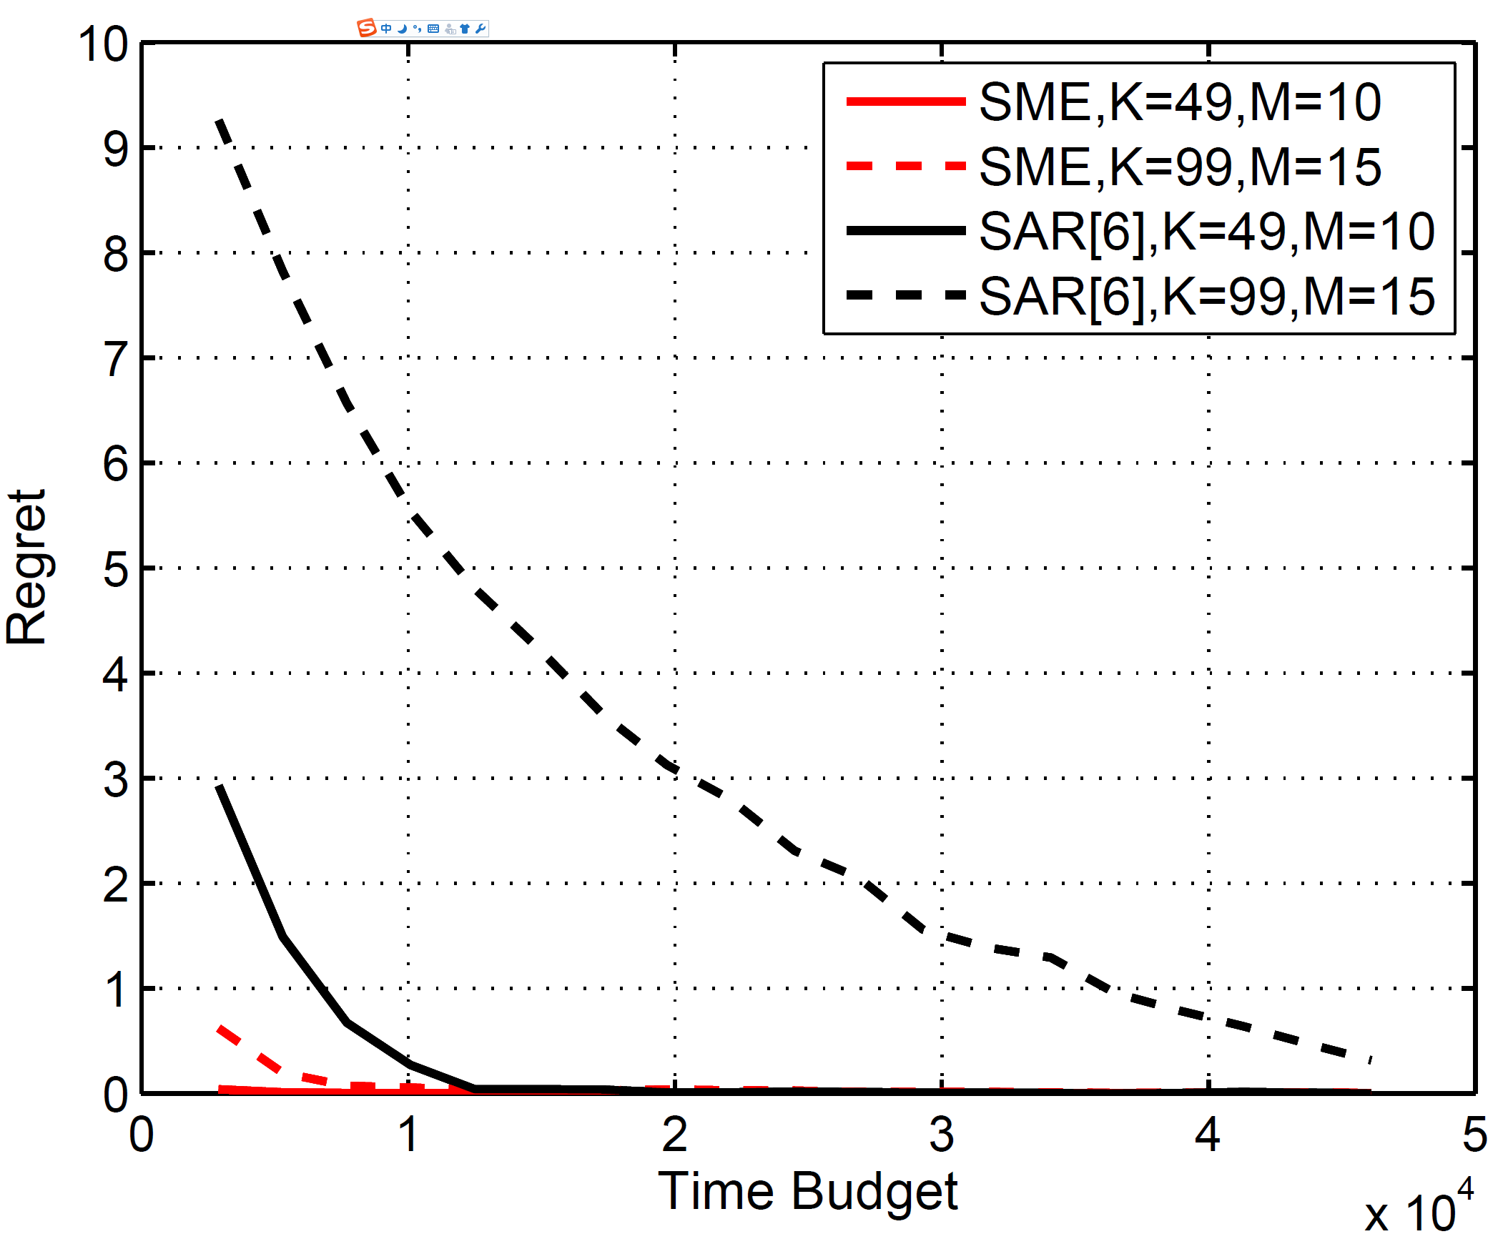
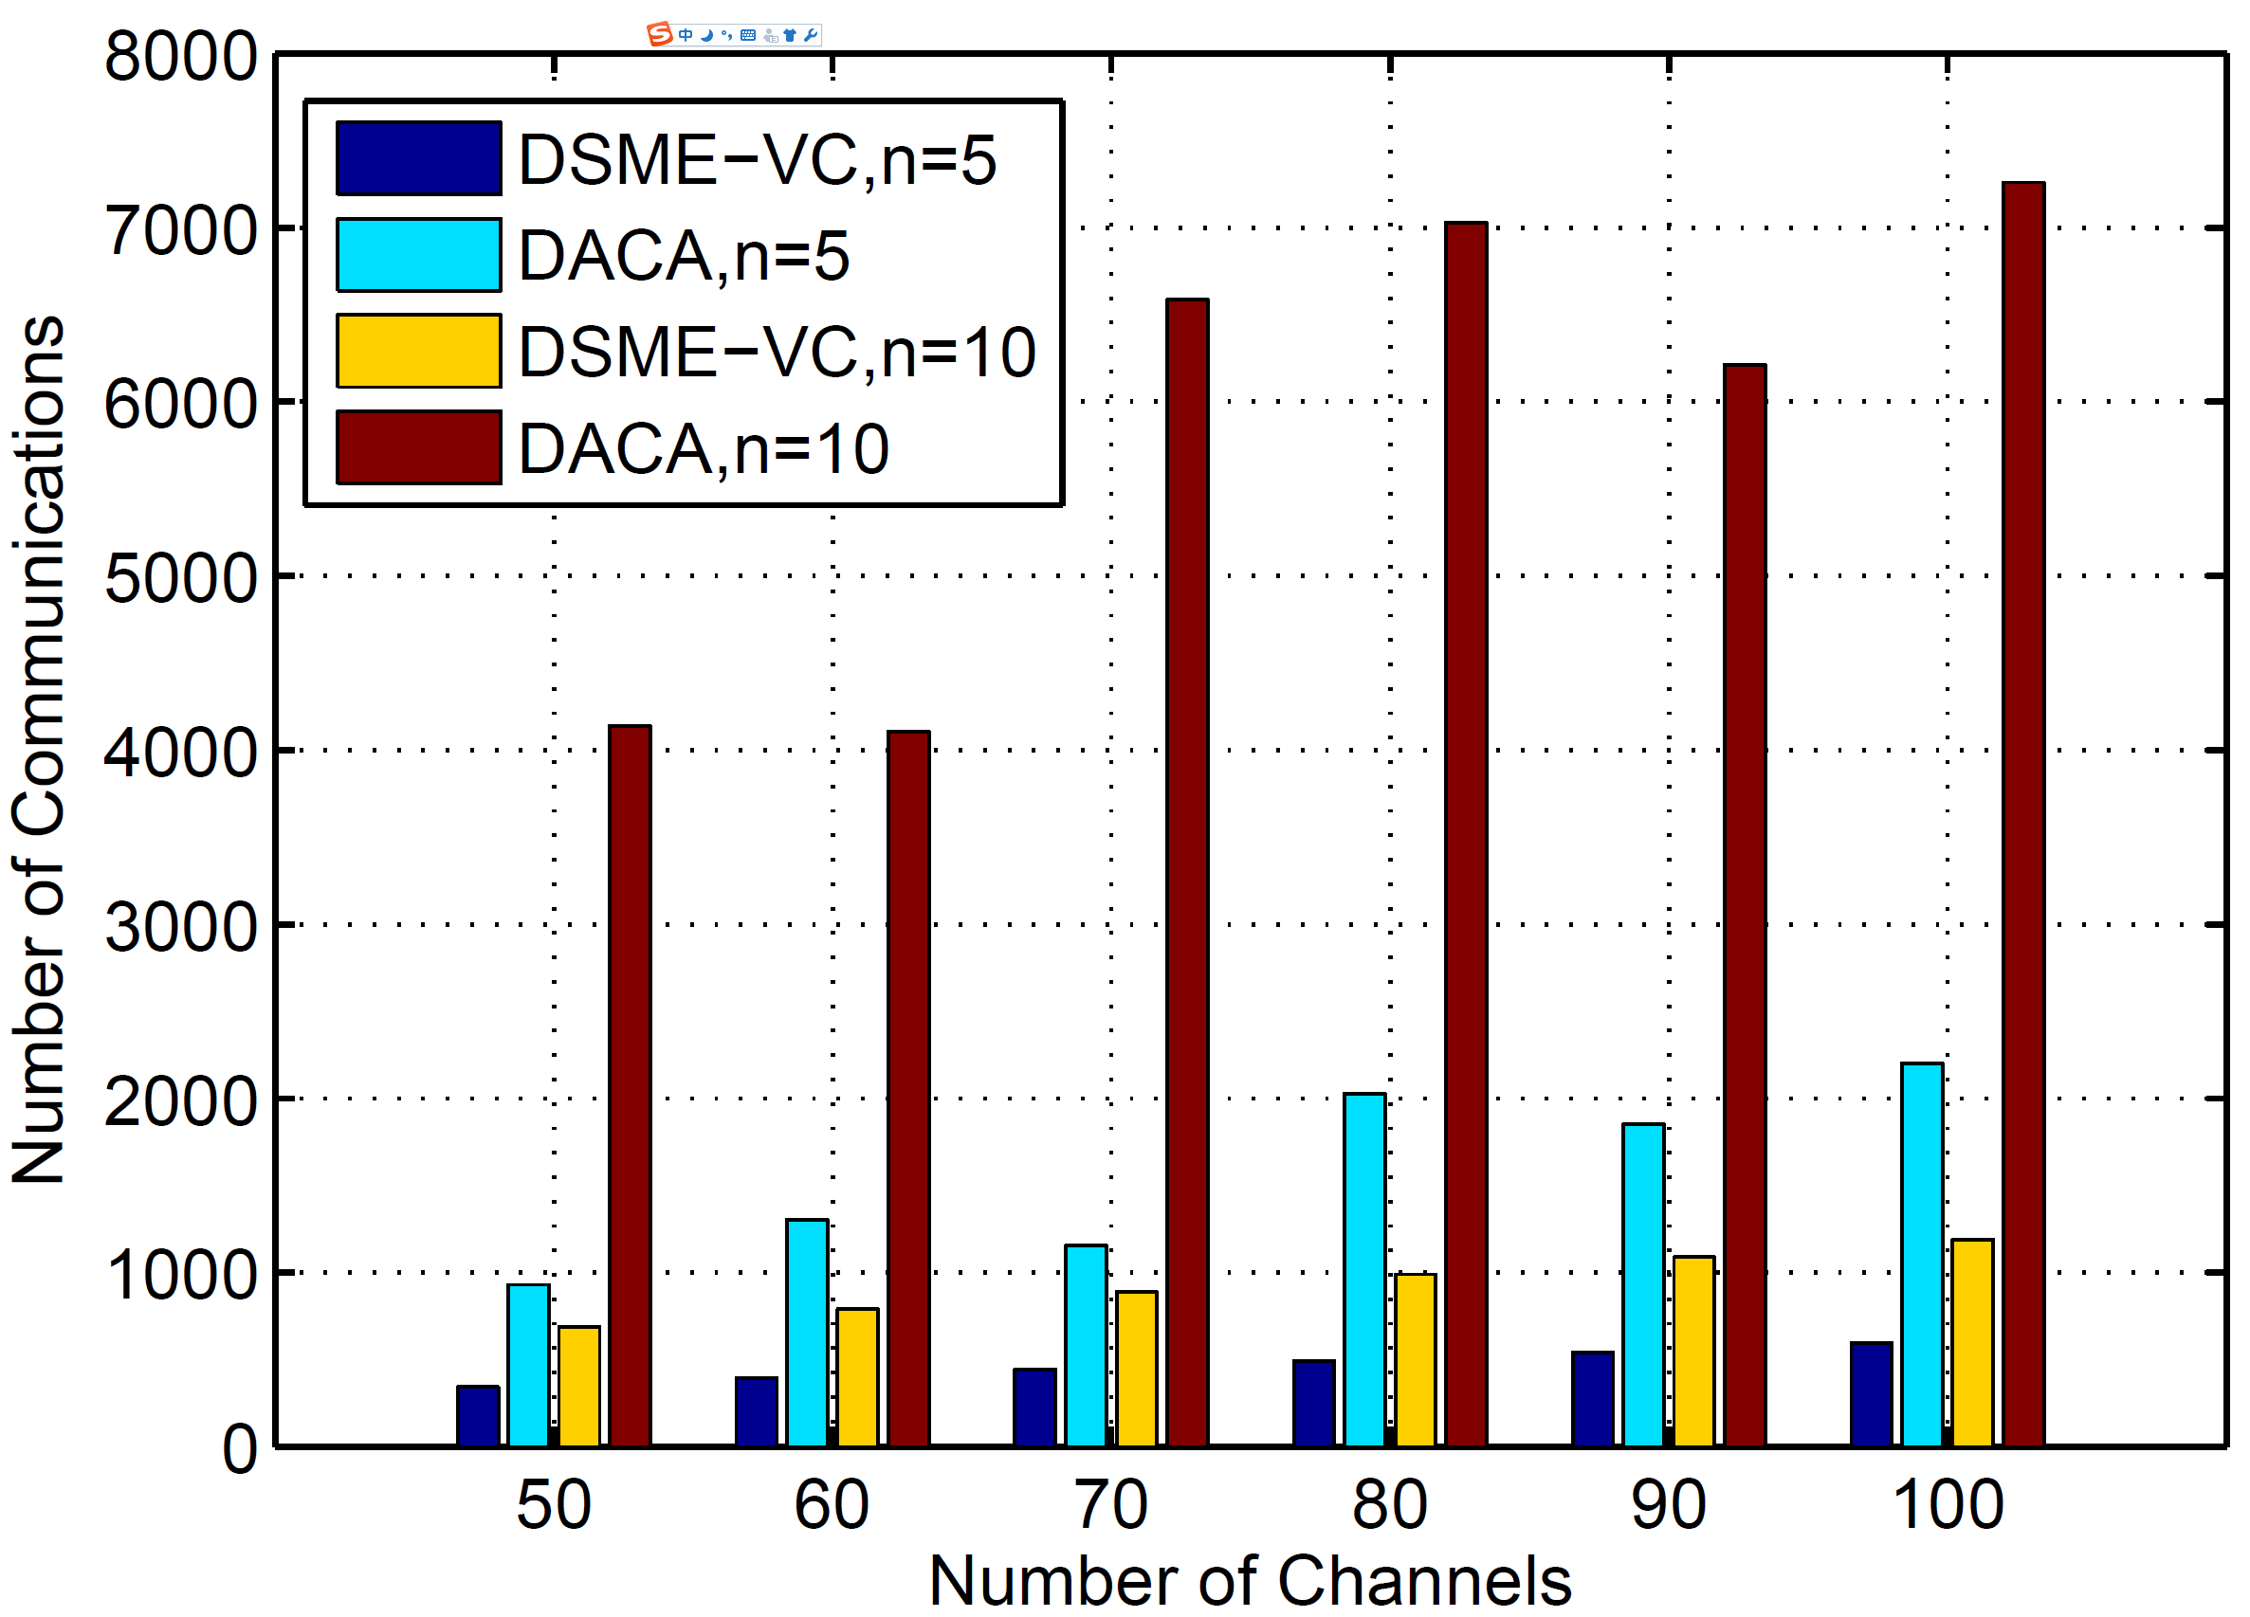
Experiment
Regret comparison for single sniffer
Communication cost for each sniffer

Slide 20
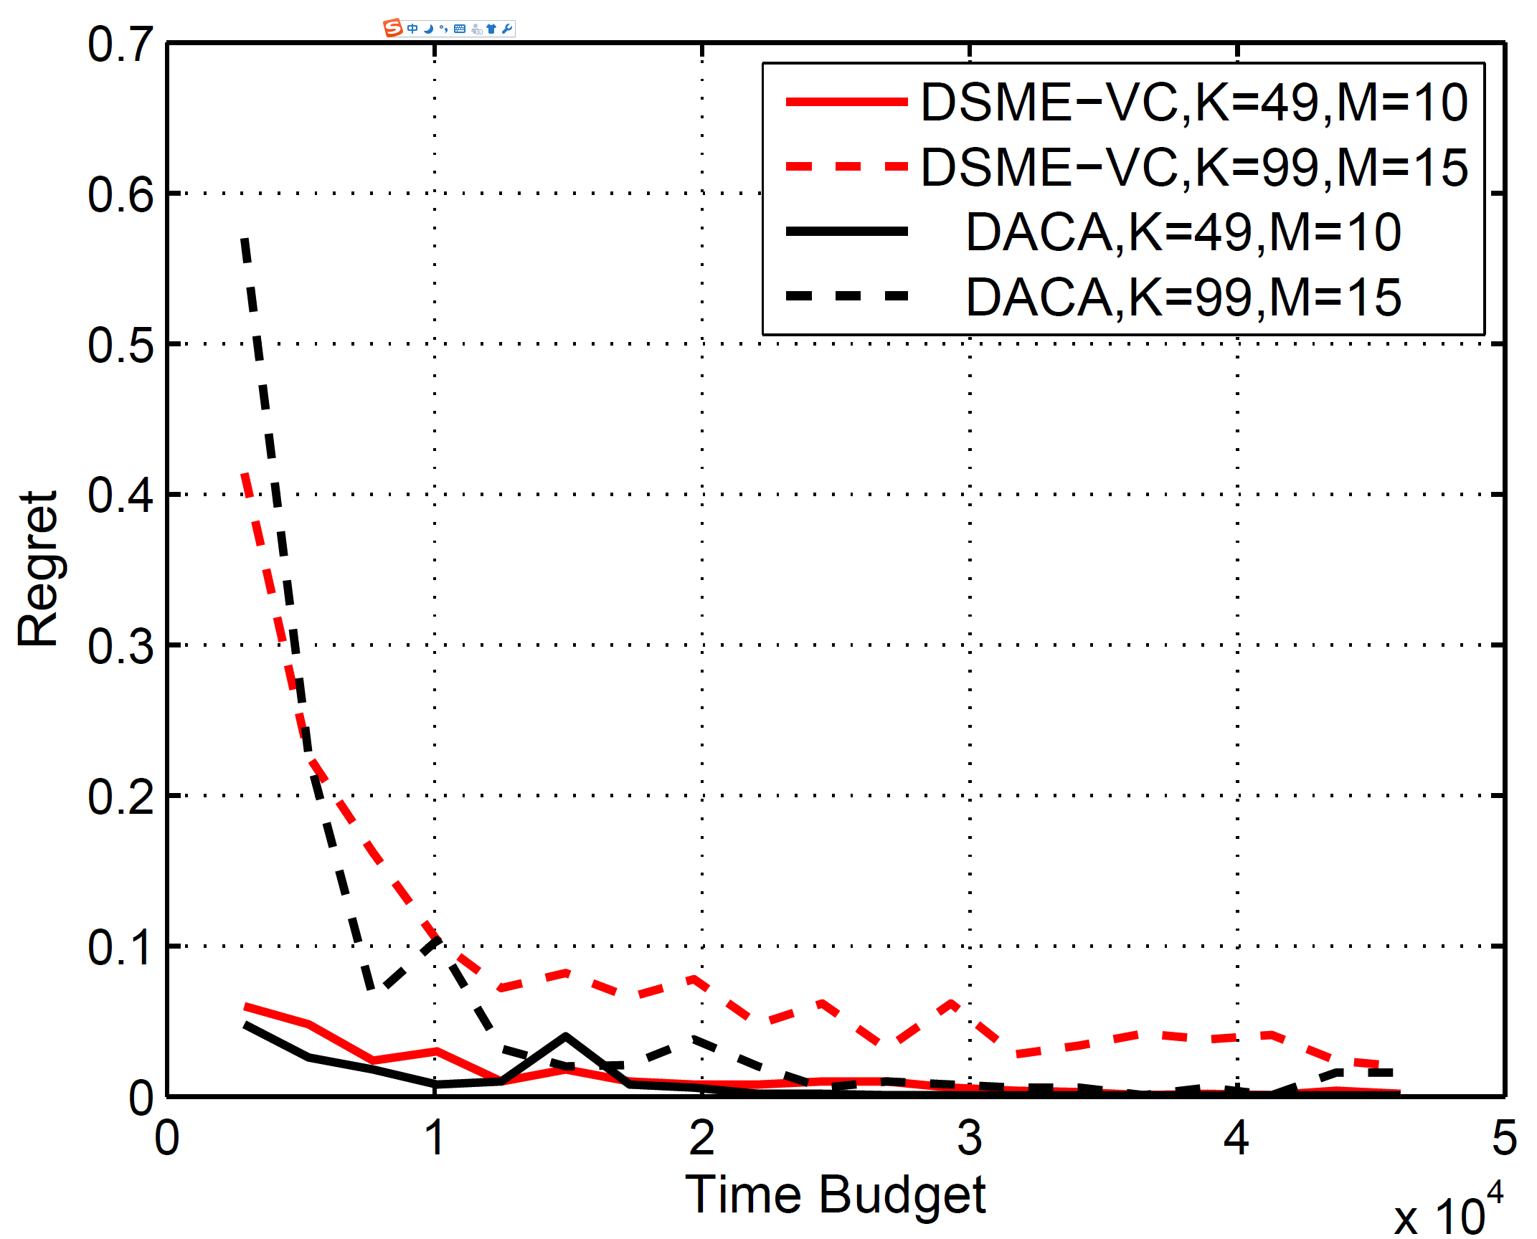
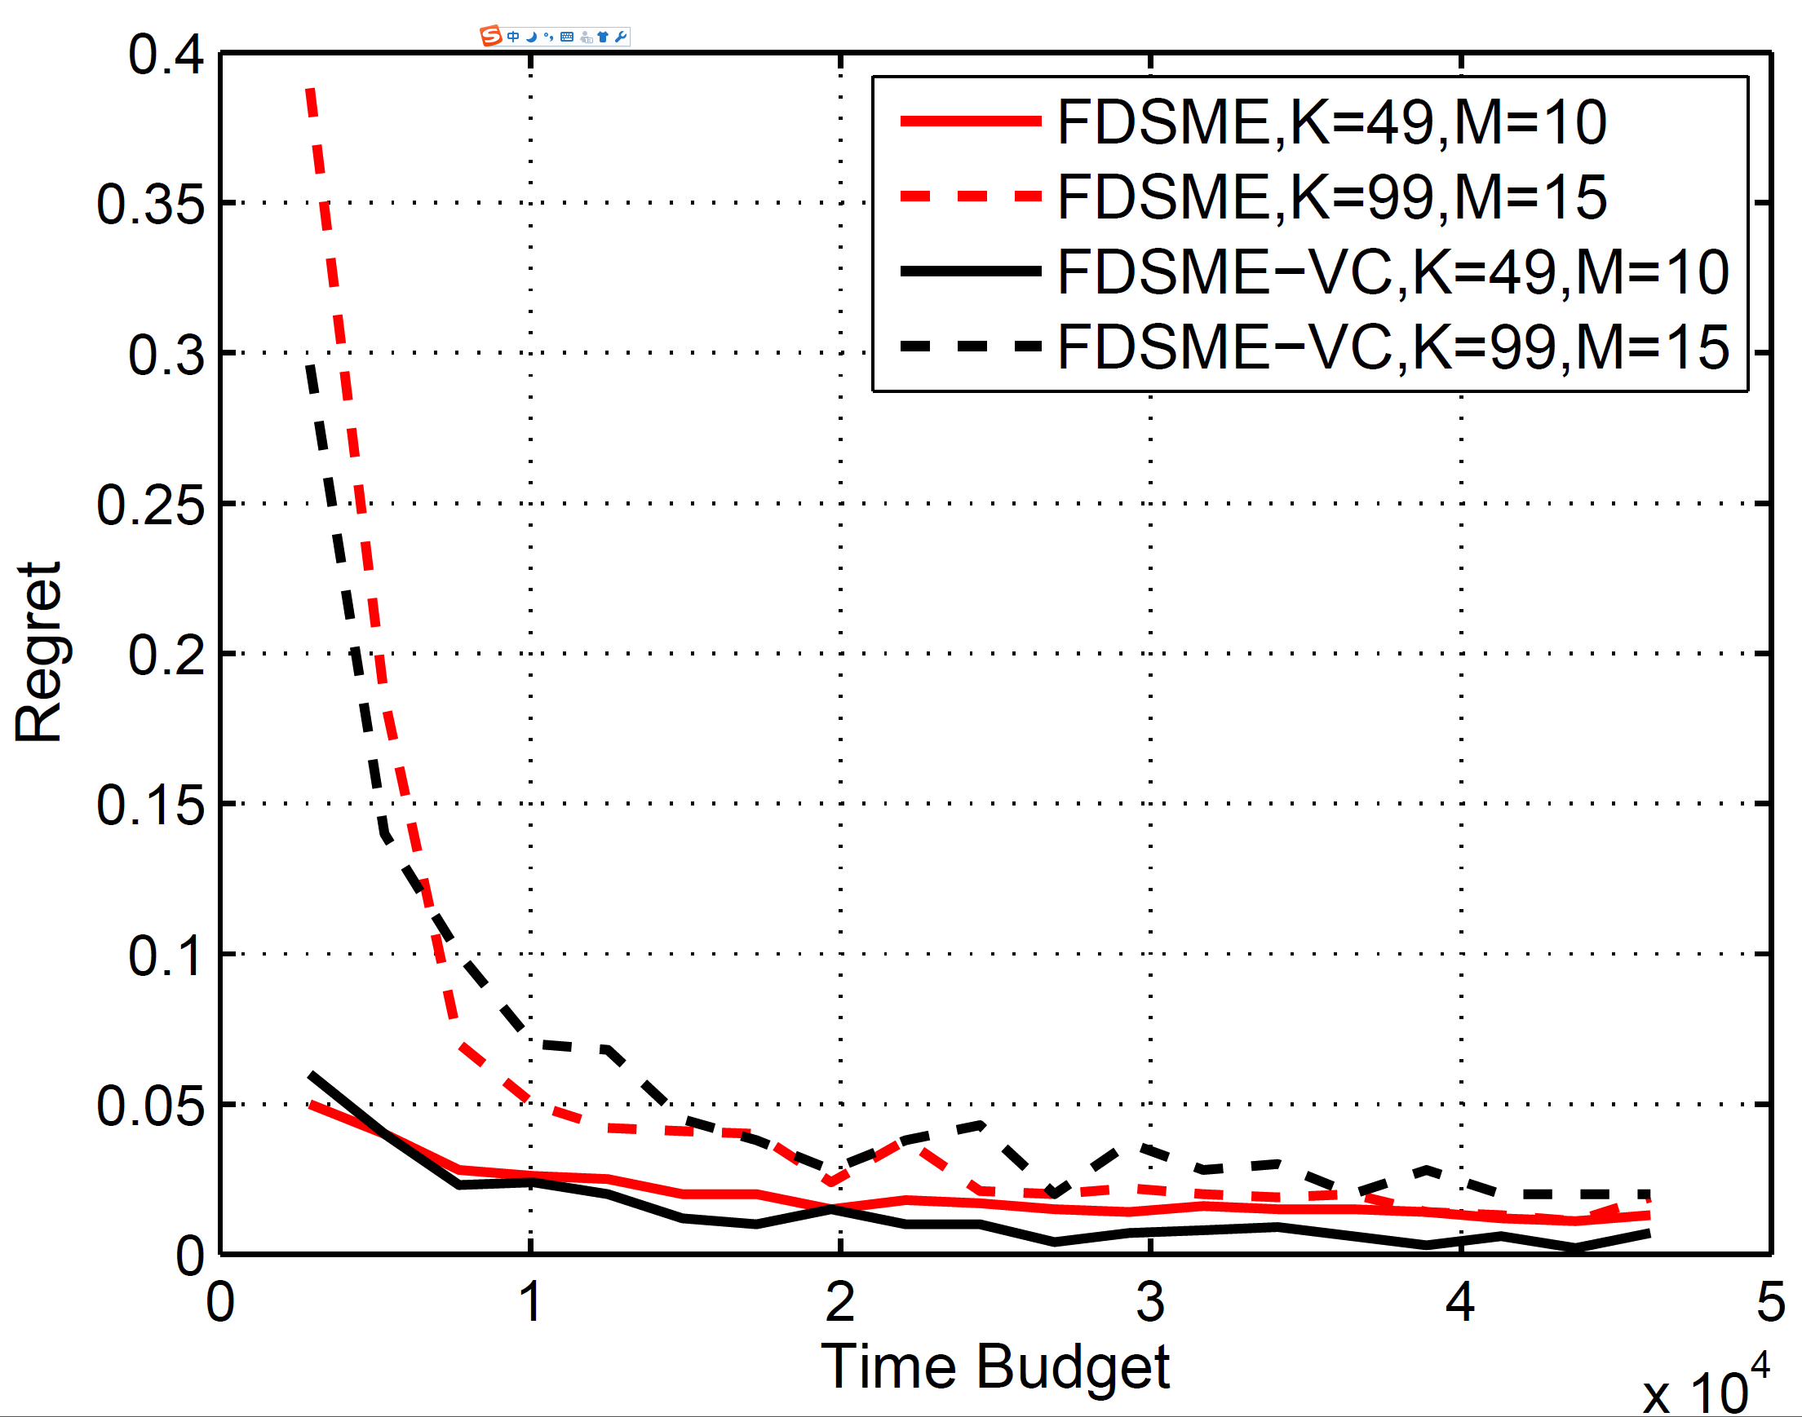
Experiment
Multiple sniffers with communication
Multiple sniffers without communication

Slide 21
Experiment
Compared with SAR, our single sniffer algorithm improves the accuracy and efficiency for more than one hundred times
Compared with the algorithm using virtual channel, auction based algorithm improves the accuracy of channel selection for more than 30%, but has much higher communication cost
In fully distributed setting, two algorithm have roughly the same performance

Slide 22
Conclusion
By modelling channel selection problem in wireless monitoring as an exploration bandit problem, we studied both single sniffer and multiple sniffer monitoring scenarios
A few single or distributed exploration bandit algorithms are proposed in our paper for different practical scenarios
Both theoretical analysis and simulation results show that our algorithms have excellent performances in different scenarios of channel selection in wireless monitoring

Slide 23
Q&A

