Slide 1
Design and Implementation of 16 bit multi-cycle
Micro-processor using RISC Architecture
Abdullah Al Owahid
Grad. Student
ECE, Auburn University

Slide 2
ISA
R-type
I-type
J-type
Opcode | Rd | Rs | Rt
Opcode | Rd | Rs | Imm. Opnd.
J | Label, N=12, -2048-2047
JNZ/JZ | Rd | Label, N=8, -128-127
 | La
Jal | Label, N=12, -2048-2047
Jr | xxxx | xxxx | xxxx

Slide 3
ISA (contd..)
R-type
Add/Sub/And/Xor | Rd | Rs | Rt | *
0000 | 0000 | 0000 | 0000 | 0000
Slt | Rd | Rs | Rt | Rd=1,if Rs<Rt
Seq | Rd | Rs | Rt | Rd=1, if Rs=Rt

Slide 4
ISA (contd..)
I-type
Lw | Rd | [Rs] | N | Rd=[Rs+N]
Sw | Rd | [Rs] | N | [Rs+N]=Rd
Addi | Rd | Rs | N | Rd=Rs+N
Movi | Rd | N, -128-127 |  | Rd=N

Slide 5
Register File
Name | Number | Use
$zero | 0 | Hardwired zero
$at | 1 | Temp. reg for swap
$v0-$v1 | 2-3 | Return value register
$a0-$a1 | 4-5 | Argument register
$t0-$t4 | 6-10 | Temporary register
$s0-$s2 | 11-13 | Saved register
$sp | 14 | Stack pointer register
$ra | 15 | Return address

Slide 6
Data Path
M8
1 0
M7
3 2 1 0
1
unsigned16
z
1
unsigned16
msb
into_pc
data_to_mem
sign4
0
from_pc
M5
0 1 2 3
alu_addr
3-0
2 1 0
M4
A
L
U
rr1
wrdata
M
E
M
I
R
7-4
M2
0 1 2
REG FILE
0 M1 1
PC
rr2
rd1
ALU_OUT REG
inr
rd2
1
M6
0 1 2 3
11-8
M3
0 1
rr3
pc_wr
wrreg
ra
sign8
IorD
mem_en
rd_wr
sign12
fetch
rd_ra_rs_sel
pc_updatel
rd_ra_sel
reg_src
OR
pc_sel
reg_wr
A_sel
B_sel
func
jnz
jz
Alu_reg_en
CONTROL UNIT

Slide 7
FSM Control
Inst. Fetch & Decode
00
10
01
lw, sw ALU op, addr. calculation
13 inst. R,B,I,J type
ALU op, reg rd/wr
pc+1
11
lw mem&regwr. or
sw mem wr. 3
pc+1

Slide 8
FSM-Output

Slide 9
FSM-Output (contd..)

Slide 10
Simulated Data
0: data_fr_mem = 16'b0101010000100011;//seq $4,$2,$3//$4 should be 1
1: data_fr_mem = 16'b0100010100100100;//slt $5,$2,$4//$5 should be 1
2: data_fr_mem = 16'b1001011010000000; //addi $6,-108//$6 should be -128
3: data_fr_mem = 16'b0000100001010110;//add $8,$5,$6//$8 should be -127

Slide 11
Simulated Data (contd..)
4: data_fr_mem = 16'b0001100101010110;//sub $9,$5,$6//$9 should be 129
5: data_fr_mem = 16'b1000101010010101; //addi $10,$9,#5 //$10 should be 134
6: data_fr_mem = 16'b1010000000001111;//J Label,Label=15,pc will changed to 15
15: data_fr_mem = 16'b1011100000000111;//JZ $8 Label=7//$8 is not 0,so pc will be 16

Slide 12
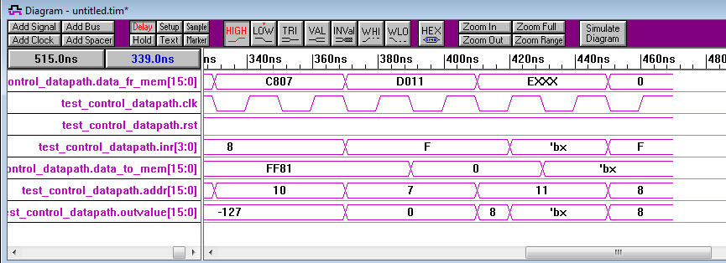
Simulated Data (contd..)
16: data_fr_mem = 16'b1100100000000111;//JNZ $8 Label=7 this time jump will occur
7: data_fr_mem = 16'b1101000000010001;//JAL Label = 17,save ra=pc+1
17: data_fr_mem = 16'b1110xxxxxxxxxxxx;//JR return to address 7+1
8: data_fr_mem = 16'b0000000000000000;// NOP

Slide 13
Advantage
-- Utilizes double edge trigger
-- 13 instruction out of 15 completes in 2 clock cycle
Disadvantage
--Positive edge required at the beginning

Slide 14
Question & Answer
Thank You

